Slide 1
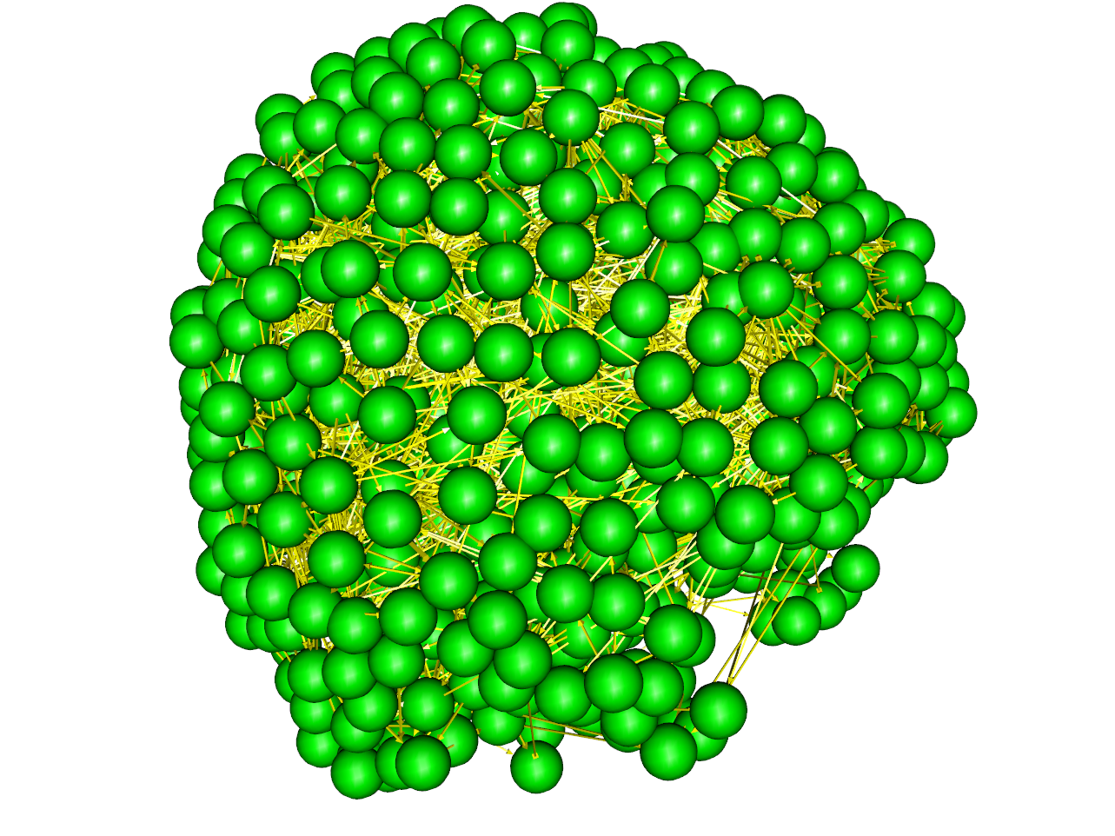
LARGE SCALE GRAPHICAL
MODELING OF BRAIN ACTIVITY
The model: Our group develops accurate and valid methods for estimating graph edges and orientations between nodes from brain activity at multiple time scales and data sources (MEG, EEG, fMRI). Using machine learning tools Bayes networks models are updated with data samples and statistical association tests. These models can be used in small scale (5-10 nodes) for testing CNS theories (ASD, SZH, etc.), and in large scale (1k-1m nodes; ) network complexity modeling can help to rethink mental illness as network communication failures.
What is new inside? We have developed model estimation methods focusing on: 1) Acyclic and, 2) Cyclic structures. Acyclic methods relevant to brain data are fGES and IMaGES. Such models assume that the joint probability distribution can be factored into individual conditional probabilities: P(A,B,...,Y, X)=P(A)P(B|A)...P(X|Y), and then searches over candidate graphs across a series of individual datasets using a novel penalized likelihood: IMscore=-(2/m)Σ_{i}ln(ML_{i})+ckln(n) (a modified BIC with ML_{i} being the max likelihood of dataset i, for m datasets of size n). A recent method, FASK, can identify cyclic brain graphs by using an orientation rule based on testing the next rule for each pair of adjacent nodes: If {E(XY|X>0)/sqrt((E(X²|X>0)E(Y²|X>0))} > {E(XY|Y>0)/sqrt((E(X²|Y>0)E(Y²|Y>0))} then orient X ->Y. Extensive simulations and real data applications have shown the accuracy of FASK to recover cyclic structures of increasing complexity.
Why is this important? Prior to FASK there was no such algorithm to find
all possible cyclic graphs in neuroscience data allowing for novel bio-markers of
various mental illness and diseases of aging (eg. Alzheimer’s).
End users: Any one with a need to find cycles in neuroscience data, fMRI, EEG,
MEG and neural spike trains. Even with 1k nodes search is fast on most clients,
and identifies a cyclic graph within minutes (fig insert 1k nodes 87k edges).
Stephen José Hanson,
Rutgers
Clark Glymour,
CMU
Grant support: NBIB,NIA
Notes:
NOTES: Brain networks are known to be at the basis of many kinds of cognitive and perceptual functions. Moreover at the basis of mental illness are various disruption of informational flow in brain networks. Our project focuses on developing Machine learning (Bayes networks) search methods for identifying brain networks as graph structures (edges and nodes) using time series from various neuroscience data (fMRI, MEG, EEG & neural spike trains). Our methods have been benchmarked and shown to recover known graph structure in small-scale (10-100 node) simulations. We can reliably identify both acylic and cyclic graph structures from brain data. We have been able to extend the modeling to Alzheimer’s brain data, and started to identify successive brain network alterations over time in archival data (ADNI). We have also designed some specific cognitive tasks which shows how feedback in brain networks are modulated by learning and disease (see figs below on right). Large scale graphs (1k-1M nodes) can further be assayed for complexity and scale-free properties. For example the graph below left is 1k nodes and 87k edges and shows scale free behavior.
SJ HANSON, email: jose@rubic.rutgers.edu
<number>

