Slide 1
Integrating Mobile Application and
Community-Based Initiative (CBI):
Achieving and Maintaining Zero Cases
of Ebola in Liberia
Dr. Mosoka P. Fallah

Slide 2
Background: Context of the EVD situation in West Africa
Origin: December, 2013 (Maliano, Guinea)
Declare/confirmed: March 2014
Entered Liberia (Source: Guinea): Early March-ended April.
Second Wave (most deadly): June (source: Sierra Leon)
Cases (confirmed, suspected and probable (February 2015): 22525

Slide 3
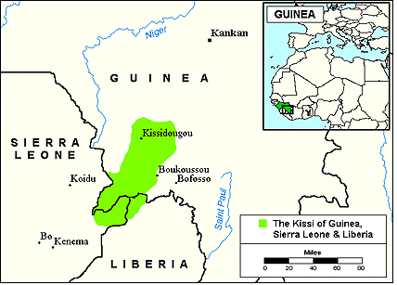
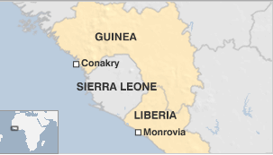
Origin and spread of Ebola: The Kissi

Slide 4
EVD situation in Liberia
Liberia: Shifted from 49% of total cases (6,500 of total of 13,200) in September, 2014 (peak of epidemic) to 39% (9712 of 25178) of total cases. (March 31,2015)
Liberia: highest death toll: 4332 of 10445 (41.4%)
Montserrado County: Most densely populated county (Monrovia-Capital City):
1. Accounted for about 50% of Liberia’s reported cases and deaths:
2. 1/3 of the population of 3.5 million Liberians
3. Challenges: densely populated urban and peri-urban slums (West Point, New Kru Town):

Slide 5
Current Sitrep of the Ebola Virus
Country | Total Cases (Suspected, Probable, and Confirmed) | Laboratory-Confirmed Cases | Total Deaths
Guinea | 3492 | 3068 | 2314
Liberia | 9712 | 3151 | 4332
Sierra Leone | 11974 | 8545 | 3799
Total | 25178 | 14764 | 10445
87%
32.4%
71.4%
Source: CDC

Slide 6
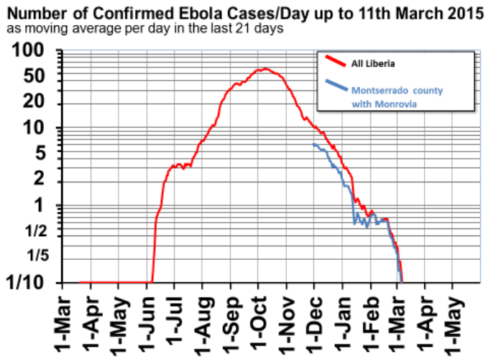
How could have gotten to Zero in spite of the dire statistics ?

Slide 7
complexities in the epidemiology of the ebola virus disease: the last ebola case in liberia

Slide 8
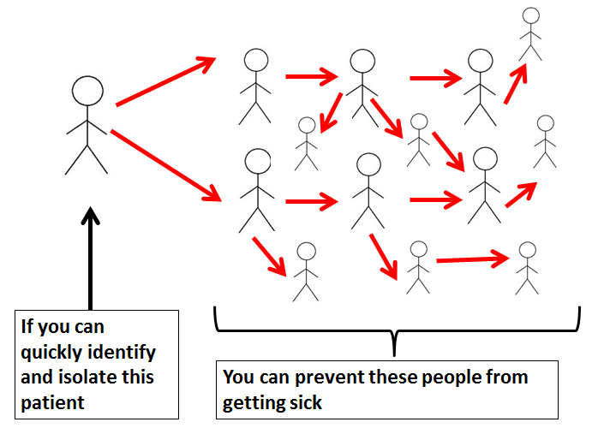
The behavior of the communities is a major driver of Ebola Transmissions
1.SECRET BURIALS
2. HIDDING THE SICK
3. INCOMPLETE
CONTACT TRACING

Slide 9
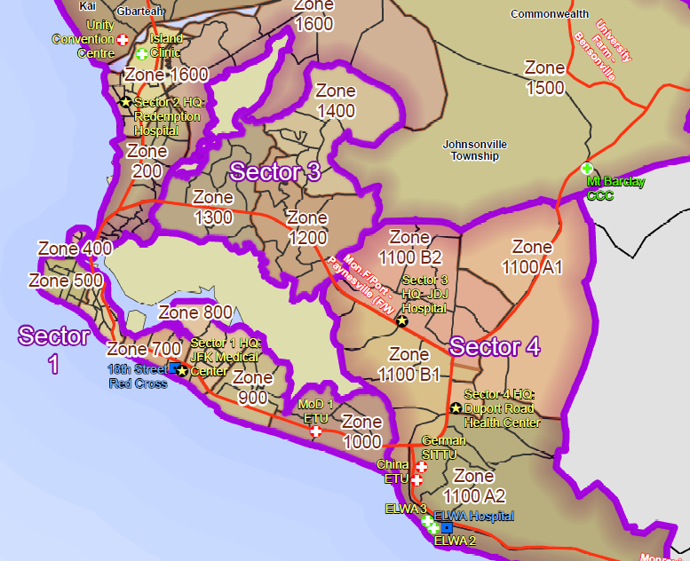
St. Paul Bridge
Montserrado
County
Red Light
SDA Cooper Hosp.

Slide 10
Transmission Diagram of St Paul Bridge Cluster, Dec 29-Feb 20, 2015
By Date of Onset*, Liberia
N=22
No. of cases
R
SY (D)
Sister
Brother
MY (A)
EY (D)
D
Niece
AB (D)
Grandmother
BY (A)
KZ (D)
Brother
EZ (D)
Housemate
MJ (A)
Neighbor
Son
Sister
Sister
Sister
D
Neighbor
RZ (D)
AK (A)
YZ (D)
Son
HZ (D)
Fiancé
Daughter
Husband
JZ (D)
Assisted into taxi
Assisted into taxi
SB (A)
HCW
JK (D)
D
Daughter
Friend
EL (D)
Neighbor
YM (A)
R
Time from date of onset to date of isolation
Herbalist
Nephew
KT (D)
PZ (D)
D
HF (A)
(D) Dead
Alive
(R) Recovered
D
Wife
KW (D)
JF (D)
D
*Date of onset is abstracted from CIF or ETU medical record; if dates of onset differ between the two, the earliest date was used.

Slide 11
Current St. Paul Bridge Cluster Cases by Date of Symptom Onset, Isolation, and Contact Follow-up,
Liberia–21 Feb 2015
21 Feb

Slide 12
Number of Contacts for Daily Monitoring,
St Paul Bridge Cluster,* Feb 19—Mar 11
*Includes contacts of two cases in Margibi and Lofa.

Slide 13
Summary of Health Facility and Community Voluntary Precautionary Observation (VPO), SPB Cluster, Feb 20
Setting | Contactsper site | HCW | Exit date | Contacts of case
Health facility
MoD ETU | 34 | 0 | 21 Feb | EL
Benson | 4 | 4 | 24 Feb | EL
Peace Home | 30 | 27 | 24 Feb | SB
SDA Cooper | 31 | 31 | 28 Feb | AB
Community VPO
Margibi (Papa village) | 54 | 5 | 21 Feb | JF
Margibi (Gaygbah) | 30 | 0 | 7 Mar | HF

Slide 14
HCW exposures at non-ETUs by active cases, Liberia
9 HCW,
4 quarantined at home, 5 monitored daily
8 HCW,
3 quarantined at home, 5 monitored daily
33 HCW,
31 quarantined at hospital,
2 in US
5 HCW,
quarantined
AB
SDA Cooper Hospital
Ambulance Team
Mawah Clinic
JFK Hospital
Date: 29 Jan
Date: 1 Feb
Dates: 1–7 Feb
Date: 7 Feb
7 HCW,
quarantined in homes
6 HCW,
4 quarantined at hospital,
1 at home, 1 new case
?
EL
Pipeline Clinic
Benson Hospital
JK
Benson Hospital
Date: 30 Jan (?)
Date: 30 Jan and 31 Jan
Date: 13 Feb
27 HCW,
quarantined at Peace HC
SB
Peace Home Clinic
Date: 3-4 Feb (from CIF)
5 HCW,
not quarantined, monitored 2 x daily
Sector 1
JF
City Clinic (Margibi)
Sector 2
Sector 4
Margibi
Dates: 30 Jan and 31 Jan

Slide 15
THE ORIGIN OF THE COMMUNITY-BASED INITIATIVE (cbi): the West point slum

Slide 16

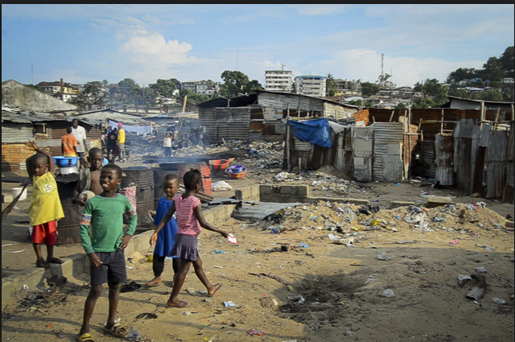
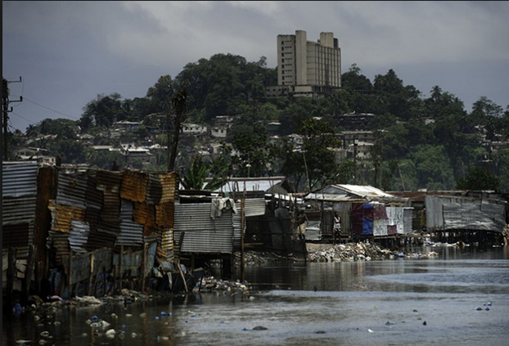
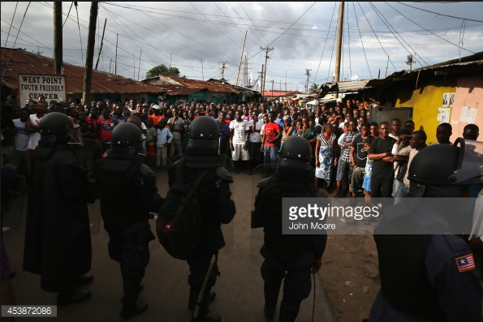
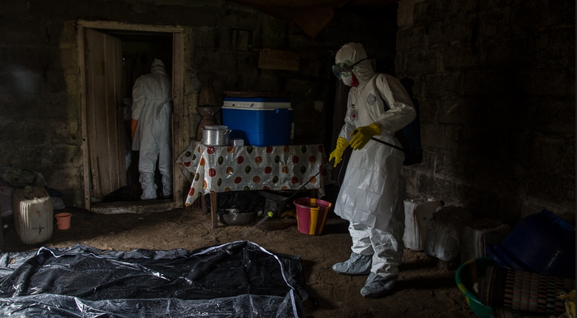
Ebola in west Point, (2)Meeting Kissi Governor;
Secret burials, (2) Holding Center looted, (4)Quarantine; (5) CBI Model

Slide 17
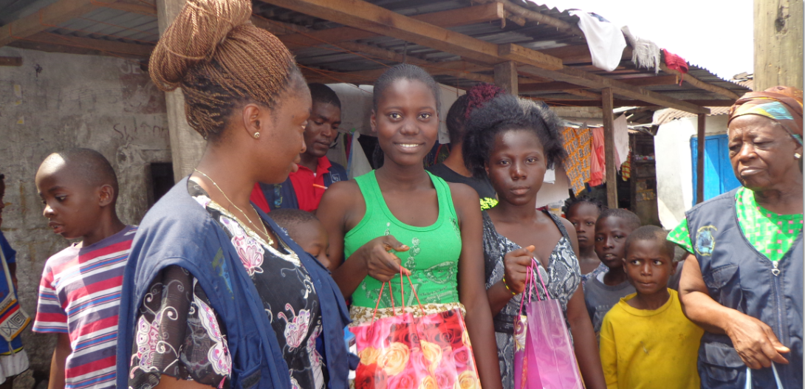
The role of Local Leaders in
West Point Slum
Kissi
Governor
From West
Point

Slide 18
Control Strategy:Community-Based Initiative (CBI)
Objective
To provide communities and individuals with the power and ability to contribute to reducing person-to-person transmission of Ebola Virus.
  Communication:
  “Horizontal” interactions with communities and individuals aimed at establishing an effective social vaccine or shield against the Ebola Virus- face-to-face communication
Adapted from Malonga Miatudila, PSI

Slide 19
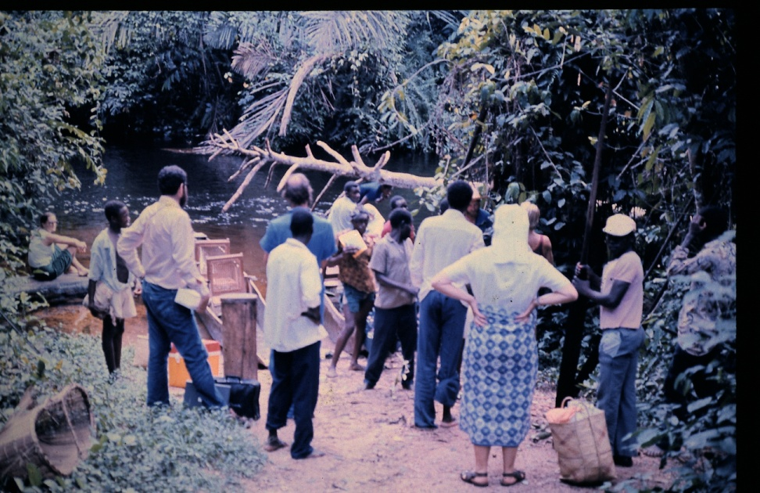
Community-based Prevention of Transmission
Communities, that are adequately empowered, can engage in a surprisingly effective fight against Ebola or any other Public Health plight.
Ebola can be quickly defeated by Local Communities with additional support from an adequately equipped, staffed and coordinated External Team (as Together Each Achieves More).
A road block established in 1976 by Yambuku’s communities as a means to reduce circulation and transmission of the Ebola virus.
A Lesson from the 1976 Ebola Outbreak
Adapted from Malonga Miatudila, PSI

Slide 20
The five strategic pillars of the Community-based Initiative
Daily search for the all sick
Daily search for the dead
Daily search for potential contacts coming as visitors
Social/counseling to affected homes and those returning from the ETU
Community-based initiative to break the transmission of EVD
Door to door awareness
Foundation
Community-led quarantine contacts
Community-led Re-integration
Peace Building

Slide 21
Intervention
Strategy
Objective
Reduce denial, community provide
Information to active case finders
Door to door awareness
Remove the sick to community care center Or treatment unit (ETU) and reduce
Transmission. Community-based
Quarantine of contacts.
Daily search for the all sick
Daily search for the dead
Uncovered hidden Bodies in homes/religious center/clinics etc
Pressure burial teams to rapidly remove the dead
Daily search for contacts /visitors
Identify hidden contacts/loss to
Follow-up. Send them back or quarantine them and reduce EVD Transmission
Liaise with psychosocial unit to provide counseling for affected homes. Spearhead the distribution of survival kit at the community level. Prepare communities to welcome survivals from ETU without stigma
Psychosocial and counseling to affected homes and those returning from the ETU

Slide 22
Implementation Plan
Engage communities in mass meeting
Plan community mapping
Conduct training in simple messages and active case finding
Provide logistics and set-up reporting structure
Dispatch team in community (1:25 houses) to collect, transmit EVD data for analysis and action

Slide 23
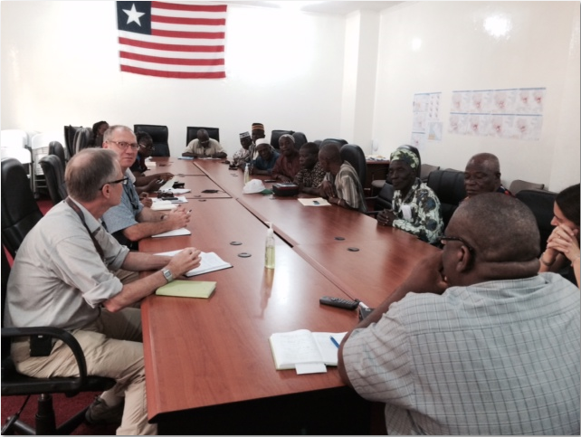
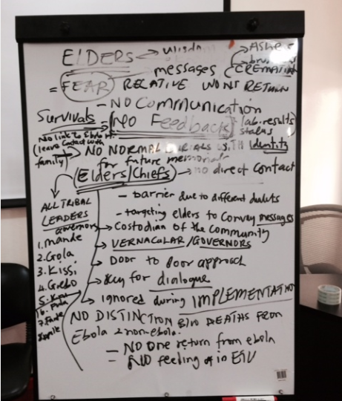
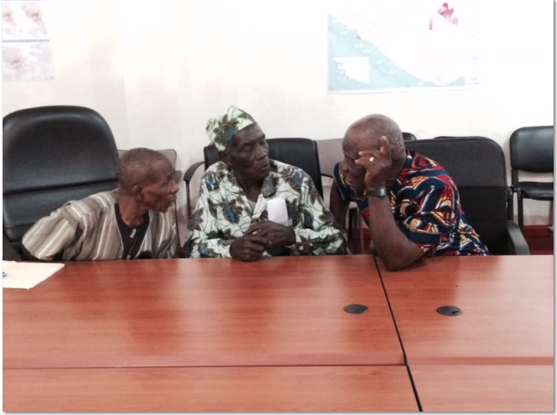
Engaging Community Leaders from the west Point Slum: Secret burials

Slide 24
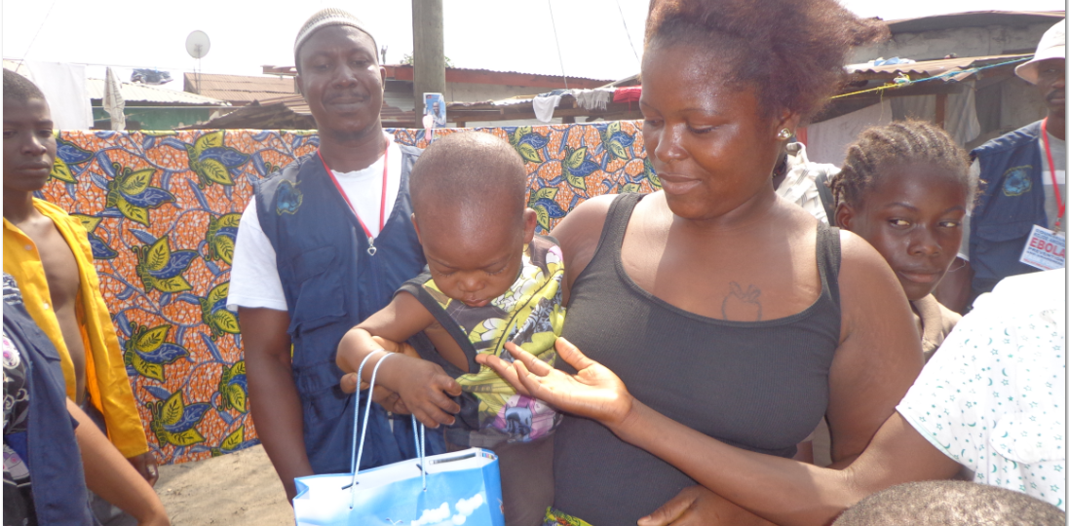
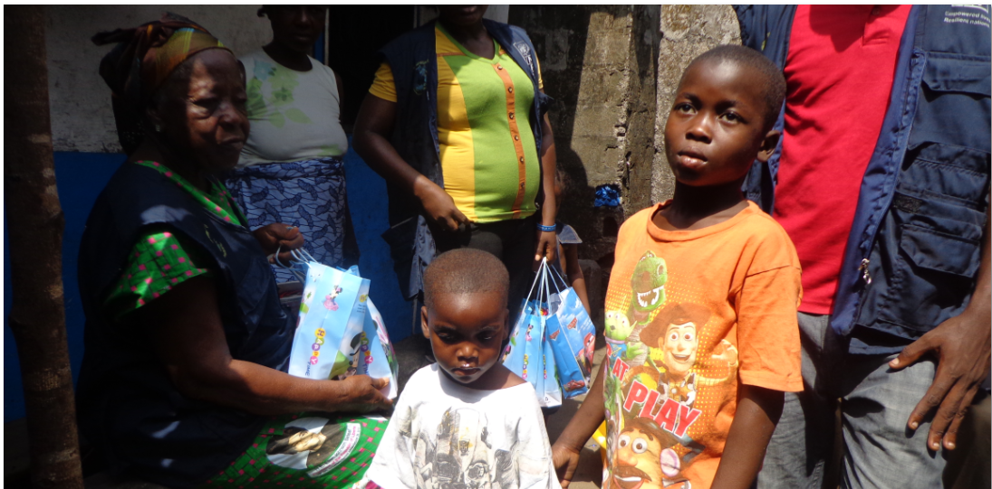
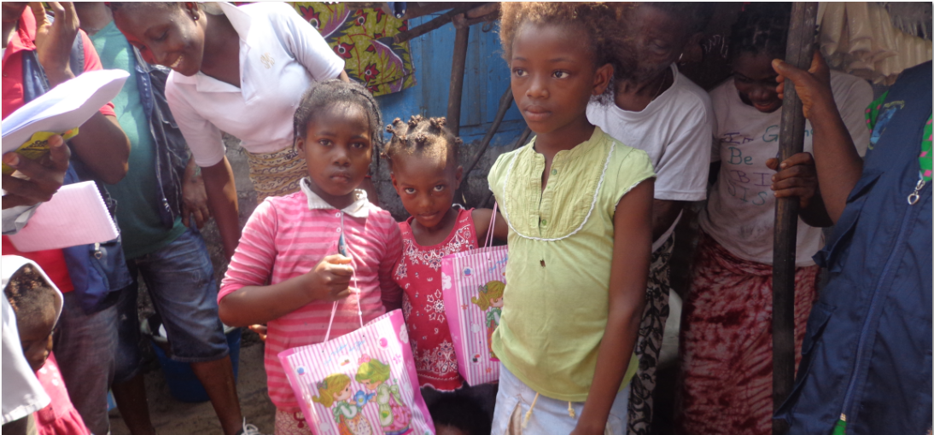
Working with Community
Leaders to reach
Ebola Orphans
Imam from West Point
Kissi governor

Slide 25
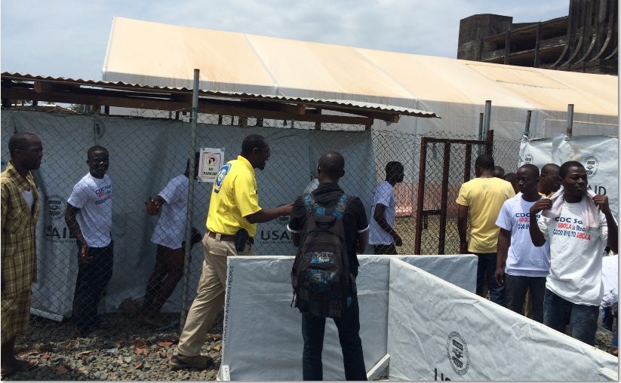
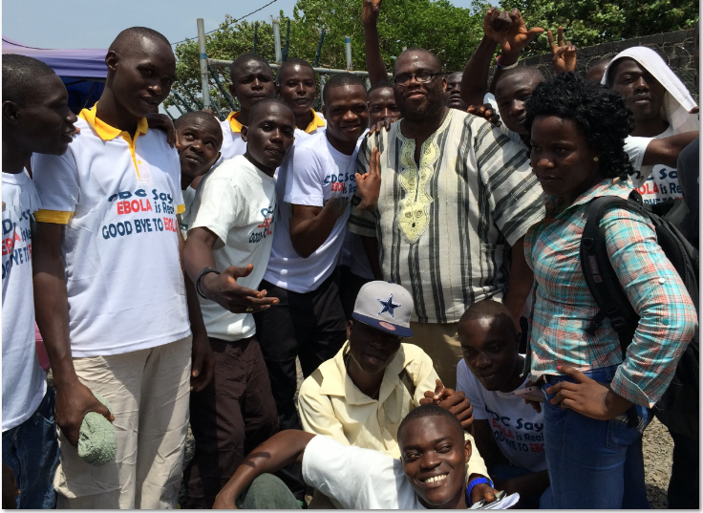
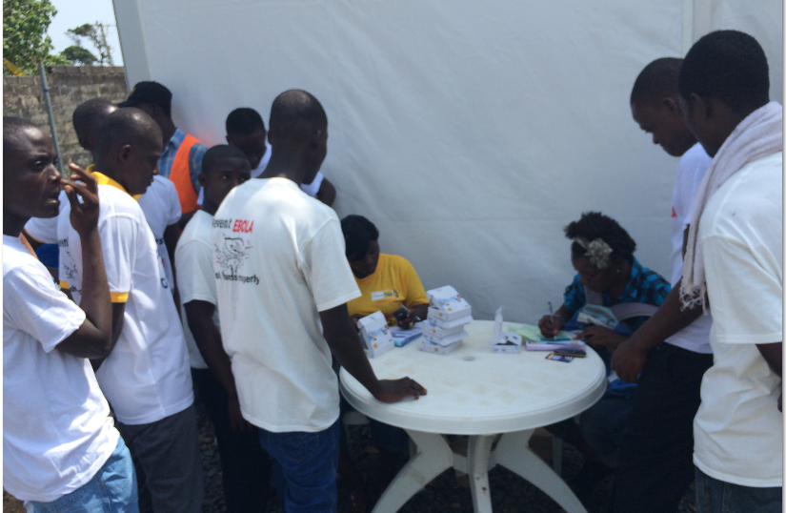
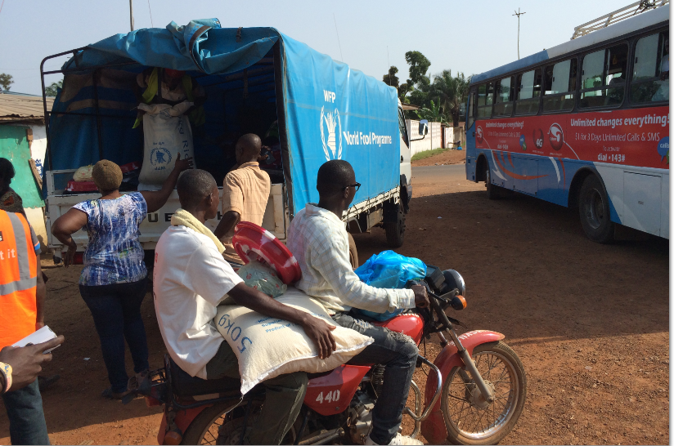
The end-game: Precautionary
Observation & VIPS

Slide 26
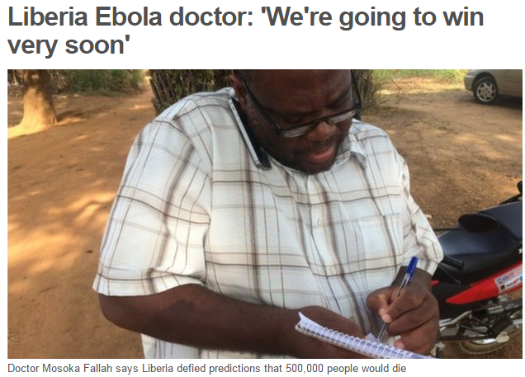
Part II: Mobile Application in the CBI Model

Slide 27
Data Flow Diagram in active case finding

Slide 28



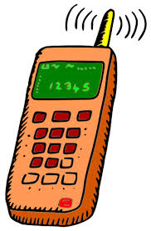
Data Flow Diagram
Project Coordinator
IT Coordinator
Psychosocial
Community Chairman
ACF
Monitor
CBI Field Coordinator
Supervisor
Administrator

Slide 29
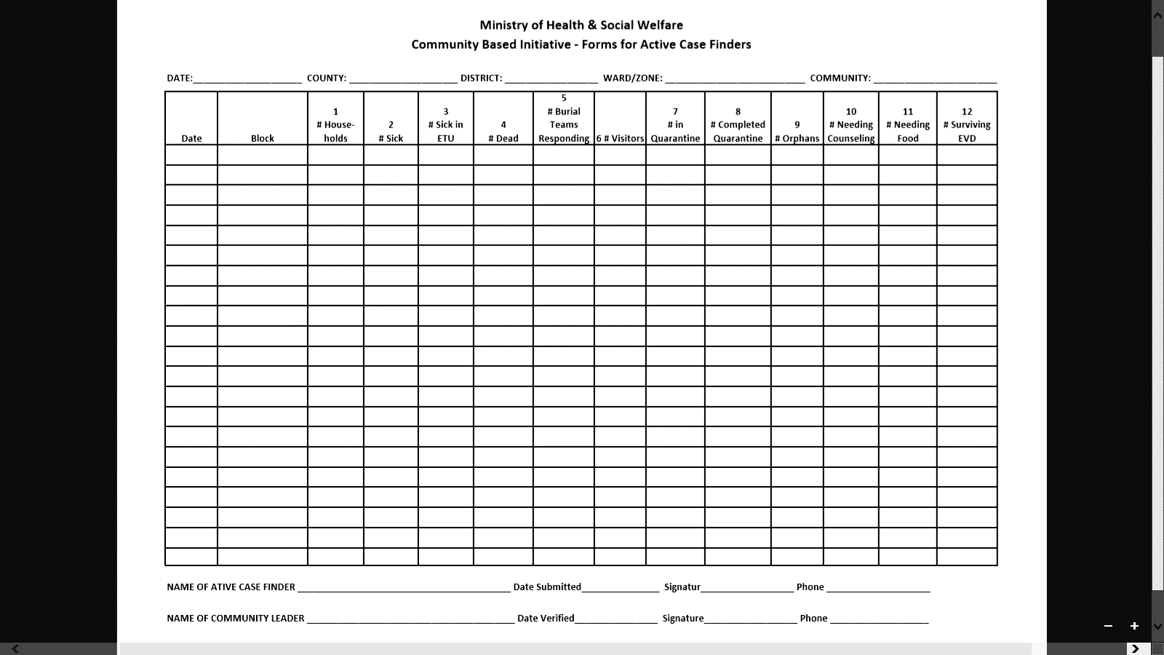
Indicators Collection Forms
Paper Forms

Slide 30
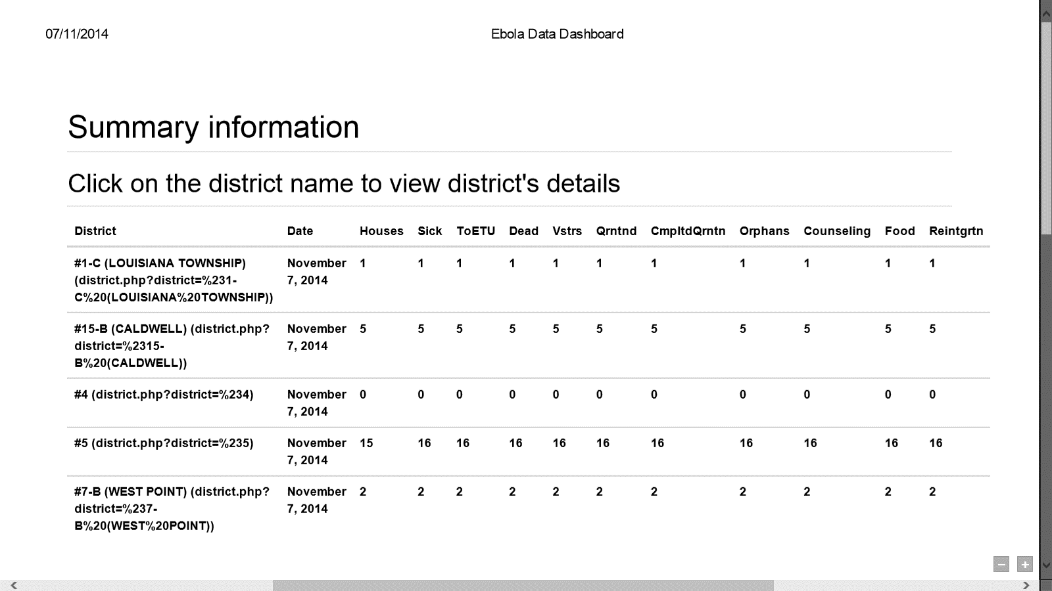
Indicators Collection Forms
Mobile App (Online)

Slide 31
WHO Districts Cases Summary Report For November 1 to December 5, 2014

Slide 32
UNDP Districts Cases Summary Report For the Month of November 2014

Slide 33
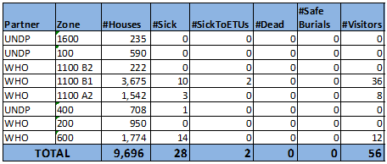
Montserrado County Cases Summary Report For January 28, 2015

Slide 34
Success stories
Averting transmissions in communities that the model was implemented: Caldwell, West Point, New Kru Town
Rapidly controlling Outbreak: Popo Peach Outbreak, Zuma Town, La Joy (Muslim Population)
Successful community-led quarantine in the following communities: Central Monrovia, Soul clinic, ELWA, Caldwell North Road
Successful re-integration in the following communities: Soul clinic, Ashmund Street
Data driven policy decisions: (1) Percentage of sick needing non-ebola care, (2) percent of unsafe burials

Slide 35
Epidemiology-surveillance tools for getting to zero

Slide 36
Enhancing the road to Zero Cases: Integrated surveillance system
Case Investigation
Contact Tracing
Active Case Finding
Case Detection
Epi-data management

Slide 37
Importance of Integrated Case Detection
Secret burials (2)Hidden sick (3) Hidden contacts
Active Case Finder
ETUs
walk-ins
Community dead:
pick up without
investigation
Case Investigators
Investigate 100% Case
Contact Tracing
100% contacts follow-up

Slide 38
Case Detection: Catalyst for Zero Cases of EVD in Montserrado
ETU
Case Detection
# of
Cases
Case Detection
Zero Cases
July
Aug.
Sept.
Oct.
Nov.
Feb.

Slide 39
Contact Tracing Complemented
Community Surveillance
Total Contacts | Total Tracers
3692 | 287

Slide 40
Local and International partnerships supported Community Initiative
1.Center for Disease
Control (CDC)
2. USAID-DART
(Donor)
3. NIH (Prevail
Vaccine)

Slide 41
Keeping Liberia at Zero
Cases of Ebola

Slide 42
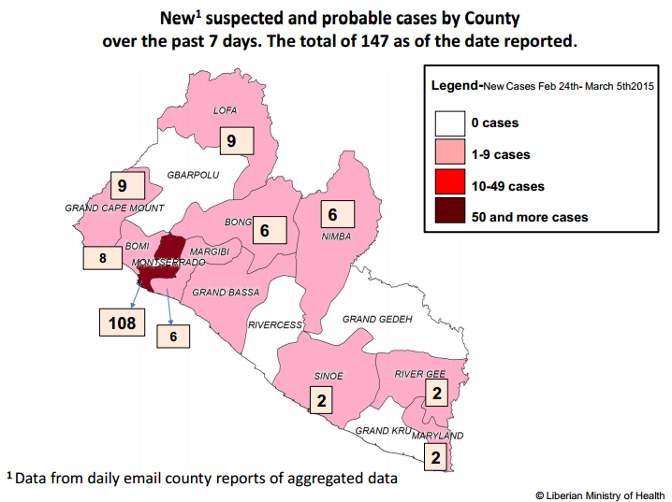
Intensive response to Increase suspected cases: No Zero Suspected Cases
Sources of suspected Cases
All known contacts of
Confirmed case (03/10/15)
2. Missed contacts that may
have died in the community
3. Triage from HFs
4. Fever Cases from schools
5. Survival infecting
Partners through sexual
Intercourse (90 days???)
Secret/community
burials
7. Robbery of ETUS ????
Strong Collaboration in the sectors among: ACF: CT: CI: ETU/Laboratories- Normal Health Services (Non-ebola illnesses- incentive to pull people out/suspected ebola cases

Slide 43
EVD SURVIVORS DISCHARGED FROM ETUs PER COUNTY
December 2014-March 2015

Slide 44
The three major premises to guide Surveillance Approach in Montserrado after the 42 days

Slide 45
#1.At the expiration of the 42 days of Zero
Confirmed cases, no human in Liberia should harbor and transmit the EVD to another person
a. We have not established an animal to man transmission of EVD in Liberia
b. No Liberian who has not left for Guinea or Sierra Leon can pose a threat of EVD to another susceptible person in Liberia
c. WHAT WILL BE THE THREATS OF EVD? VISITORS FROM GUINEA AND SL WHO BECOME SYMPTOMATIC IN LIBERIA AND WERE NEVER DETECTED

Slide 46
An EVD outbreak in any of the 14 other counties can be contained in a short period of time
a. The human capacity and skills have been developed to contained the EVD in the other counties (Examples: Lofa, Bong, Cape Mount)
b. The population is more homogeneous and less mobile
c. Most villages and towns are rural and lack very dense population
d. The center of gravity for the response is easily identifiable

Slide 47
An outbreak in Montserrado County has the propensity to spread to other counties and reverse every gains we have made against the EVD.
a. The outbreak in Zuma Town (400 houses) demonstrated the complexity of containment
b. Zuma Town outbreak spread to Margibi and could have spread to Lofa and Bomi county
c. Most of the events of Zuma were under our control yet we could not stop it from escaping to Margibi (JF) and possibly Bomi (AB,HZ)
d. Highly heterogeneous and very mobile population
e. Densely populated urban slums concentrate and amplify the transmissions
f. HCW: home treatment, poor triage

Slide 48
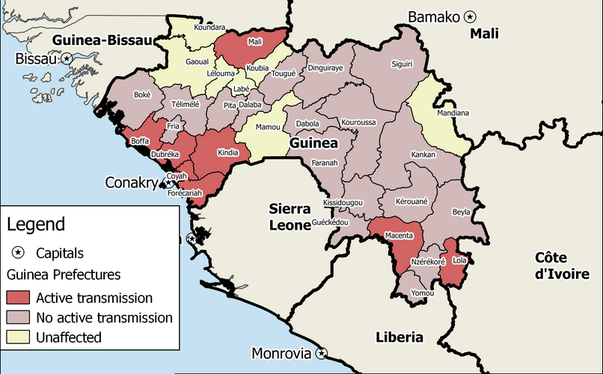
Visitors from Guinea and SL poses the greatest EVD threats: challenges

Slide 49
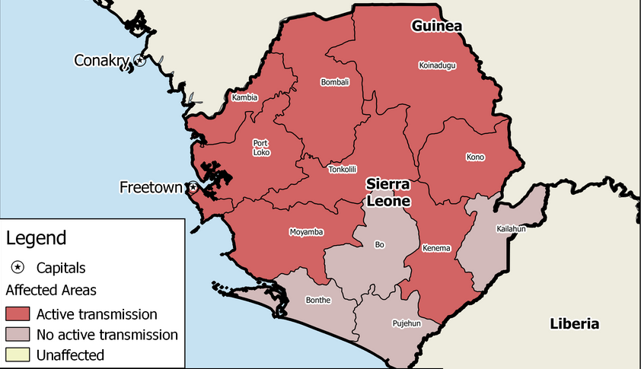
Visitors from Sierra Leon and Guinea poses the greatest EVD threats: challenges

Slide 50
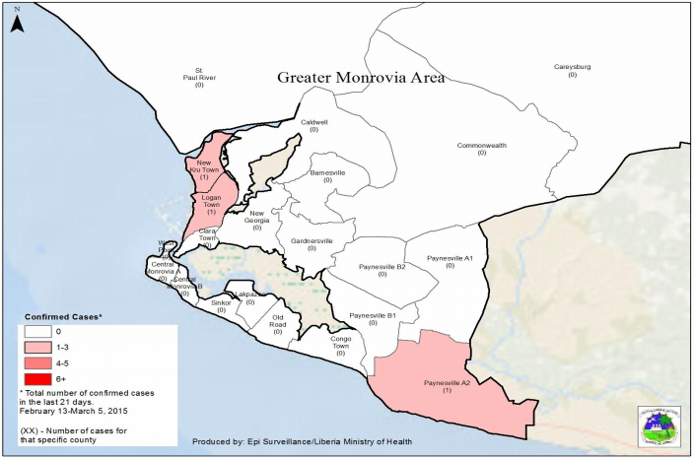
Most visitors from Guinea and SL will end up in Montserrado: challenges
Pull Factors:
Relatives resides
In Monrovia,
Improved health,
Economic &
Educational
Conditions.
Challenge:
Tracking the
Visitors in the
Complex slum
Communities.
Tracking movements
Of Taxi and
Motorbikes
Bringing visitors

Slide 51
The Surveillance Approach in Montserrado must concentrate on proactively tracking and monitoring all visitors from guinea and sierra Leon: modified us approach (the cbi model)

Slide 52
The CBI Model/ACF: Track visitors, sick & dead
IT Coordinator
Active
Case
Finders
1.Community Chairman
Paper
form
Daily
House
visits
2. Block Leaders
3. Head of Ebola
Task Force
Supervisor
Monitor
CBI Field Coordinator

Slide 53
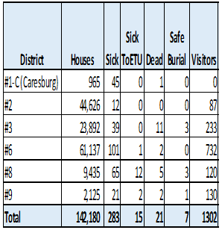
CBI model demonstrated the application of mobile applications to track visitors
November 1 to
December 5, 2014

Slide 54
CBI Model for Tracking Visitors
January 28, 2015

Slide 55
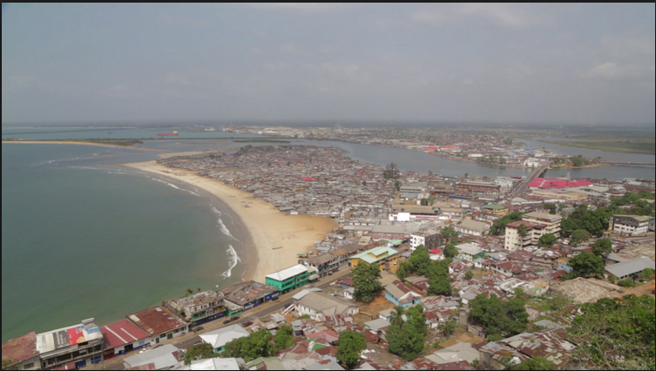
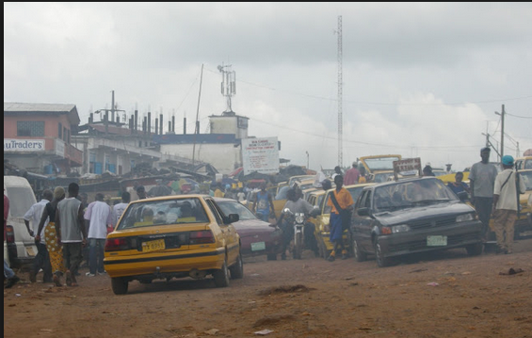
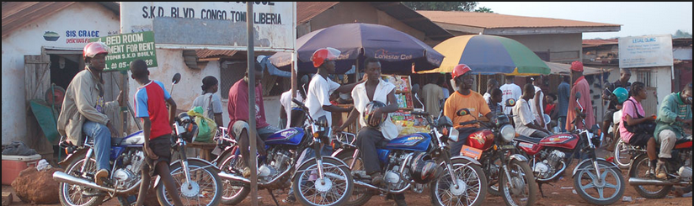
CBI model for Tracking Visitors from SL and Guinea
Embed
ACF with
Transport
Union
At all
Parking to
report on
Visitors
Local Community Chairs and
ACF daily track new visitors
CBI + Mobile
Application
1. Daily report of visitors via Mobile application
2. Daily monitoring of visitors for 21 days. (3) Communicate with cross border surveillance. 4.Any sick visitor is immediately remove by CI
Embed ACF with Motorbike parking track final destination of Visitors

Slide 56
Challenges-1
Lack of access to the backstage of the data: (a) inability to correct for late data entry; (b) inability to correct field level mistakes (must be communicated with developer via email: defeats real time use of data for decision making on the field
Mobile application freezes during data entry on the field
Lack of a constant power source in remote areas (charge phONE)
Lack of tool graphical analysis (exported into excel or copy and paste before analysis is done).

Slide 57
Challenges-2
Slow roll out of mobile application to entire county/country due to logistical challenges
Variability in internet signal
Some delinquency in submitting data timely
Supervision of user limited due to limited logistics (vehicles)

Slide 58
Results-1
The combination of mobile application and the CBI model produced dramatic results.
November 1 to December 5, 2014:
data were collected from 152,610 houses.
(a) 563 sick persons were identified- 59 suspected: Ebola Treatment Unit (ETU) as suspected and/or probable cases,
Interpretation/implication: 90% regular health service (10% ETU)

Slide 59
Results-2
(c) 169 dead bodies were found in the community, (d) 86 of these dead bodies were safely buried by the authorized burial teams,
Interpretation/implication: 50% safe burial and 50% unsafe burials
(e) 1926 visitors were tracked in the various communities

Slide 60
Challenges and Opportunities
CHALLENGES:
1. >1500 EBOLA SURVIVAL WITH COMPLICATIONS AND FACING STIGMA
2. >1000 EBOLA ORPHANS WITH FEW IN SCHOOL (HOPELESS FUTURE)
3. MATERNAL MORTALITY AND MENTAL HEALTH ISSUES IN POST EBOLA LIBERIA
4. COLLAPSED HEALTH /PUBLIC HEALTH SYSTEM-SLOWLY RECOVERING
CURRENT OPPORTUNITIES
1. BIOMEDICAL RESEARCH: NIH AND CDC CONDUCTING RESEARCH WITH SURVIVALS (5 YEARS COHORT OBSERVATIONAL STUDY)
2. DEVELOPING A PUBLIC HEALTH and BIOMEDICAL INSTITUTE
3. HELPING TO REBUILD A ROBUST HEALTH SYSTEM TO PREVENT FUTURE OUTBREAK (West African Consortium)
4. STRENTHENING MATERNAL CHILD HEALTH
5. SUPPORTING REFUGE PLACE INTERNATIONAL/NGO STARTED AT UK

Slide 61
Future directions
Expand the mobile application: (A) Current project with WHO on: IDSR+ EVD platform; (B) Surveillance of visitors from Guinea and Sierra Leon (CDC USA)
Seek partners to develop more robust mobile application that can help us transition to post-Ebola early warning system in the community.
Build an application that allows access to the backstage by local IT associates.
Identify cheaper power source and alternative signals for remote places.
Build a robust monitoring and supervision system.

Slide 62
Conclusions
Combination of mobile application and the unique CBI model contributed to the dramatic reduction in Ebola cases in Liberia.
A system that collect and transmit real time data for analysis and decision making is critical in the fight against the EVD.
Future model for control of EVD and other diseases of epidemic proportion

Slide 63
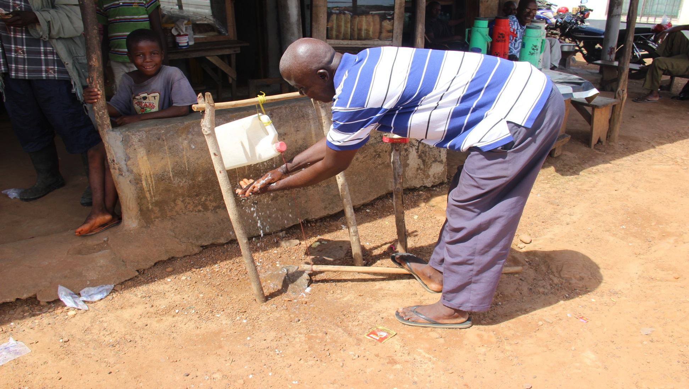
THANK YOU
Community Innovations: Appropriate Technology

Slide 64

QUESTIONS

