Slide 1
MSM U01 Projects
What’s the Math Inside? 1-slide summaries
https://www.imagwiki.nibib.nih.gov/content/multiscale-modeling-u01-projects
Collected February 2019
(in alphabetical order of Contact PI last name)

Slide 2
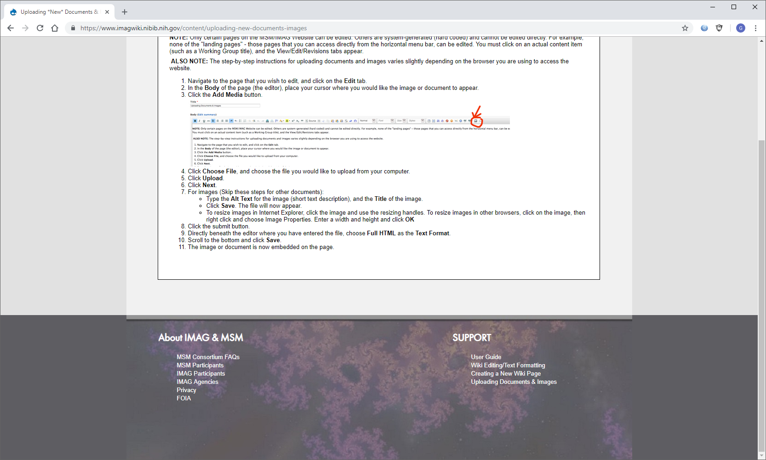
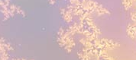
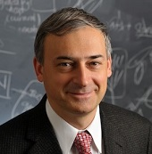
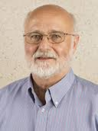
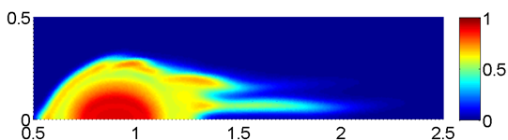
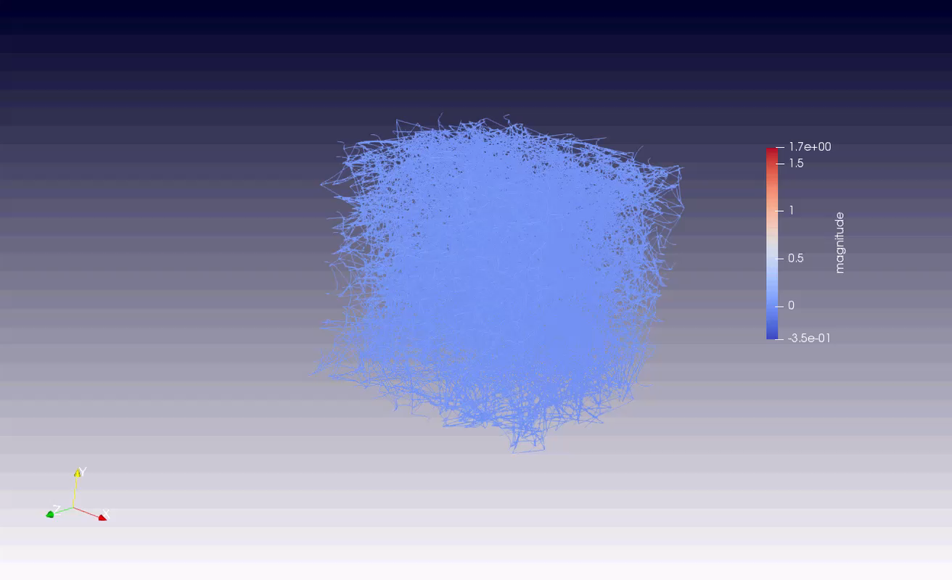
Multiscale modeling and empirical study of a mechanism
limiting blood clot growth
NIH UO1 HL116330
Mark Alber¹ & John Weisel²
Department of Mathematics,
Center for Quantitative Modeling in Biology, University of California, Riverside, CA
2. Department of Cell and Developmental
Biology, University of Pennsylvania School of Medicine, Philadelphia, PA
1. Multiphase Embolization Model. Self interaction between clot components including activated and partially platelet's, fibrin network and plasma, is modelled by a system of partial differential equations (PDE’s). The model is used to predict the risk and underlying cause of embolization with regard to clot composition, internal structure and varying shear flows (see Figure 1).
2. Multiscale Model of Fibrin Network Deformation. Fibrin, the primary blood clot component, is modeled as a 3D network using a coarse grained subcellular element method to investigate novel structural mechanism of fibrin clots’ mechanical response to external loads based on nascent cohesive interactions between individual fibrin fibers (see Figure 2).
3. Multiscale Data and Predictions. 1. Experimental data includes relevant flow conditions as well as accurate clot permeability and hydrodynamic force measurements. This allows for patient specific model simulations to determine clot mechanical stability and embolization risk. 2. Experimental data includes microscopic clot structural data and individual fiber mechanical properties which are used to calibrate models. Model predictions are validated using macroscopic experimentaly obtained stress-strain curves as well as average levels of fiber alignment and density.
4. Practical outcomes: Development of novel types of blood thinners to inhibit fibrin-fibrin interactions and fiber polymerization. Model will also lead to more accurate risk evaluation of clot rupture and embolization in specific patients.
End Users: Biomedical Researchers will use combination of tests on blood clot formation and deformation in microfluidic devices with computational modeling platform. This effort will include research labs and groups who design different clotting drugs based on targeting specific pieces of the clotting cascade.
F1: Model Simulation of Emboli Formation
F2: Simulation Movie of Stretched Network
Notes:
Instructions:
Submit 1 slide by COB Monday 2/25/19
Title - headline your theory-driven, mechanistic model
name the specific mathematical or statistical method and variations thereof
To include in NOTES section
define/explain it enough for a non-scientific person to explain to the general public (2-3 sentences)
mention how can machine learning and AI help your project (2 sentences). Machine learning algorithms are used to analyze and compare experimental and modeling data. All developed models were analyzed using sensitivity analysis and uncertainty quantification to demonstrate their robustness and predictive abilities.
List future challenges or next steps after your project is done (1 sentence). We plan to develop both models further to study clot embolization, compression and contraction in specific patients.
Further details for Notes section - For the following communities (2 sentences):
Behavioral modeling: explain the new theories that will integrate within person dynamics with between person dynamics
Multiscale modeling: explain how the math will address methodological challenges (e.g.: crossing scales, sparse data, uncertainty, modularity, spatiotemporal simulation challenges, etc.). We develop coarse grained justification for the subcellular element models of platelets, red blood cells and fibrin network.
Medical simulation: explain the math challenges being overcome. We were able to couple subcellular element representations for cells with particle representations of the blood flow and molecular signaling submodels.
e.g. collision dynamics, cloth dynamics, haptics, etc.)
Analysis: explain how new statistical approaches will provide mechanistic understanding of the system. All developed models were analyzed using sensitivity analysis and uncertainty quantification methods to demonstrate their robustness and predictive abilities.
PI name, email: Mark Alber, malber@ucr.edu

Slide 3
Active Learning and Deep Reinforcement Learning on Agent-based Models
The model : Agent-based models (ABMs) are increasingly used to represent multi-scale biological systems. However, given their complexity, ABMs are generally treated as experimental objects, with associated limitations with respect to their calibration, parameterization and use. We use advanced machine learning approaches for model/parameter space characterization for meta-model identification (active learning/model exploration) and adaptive control discovery (deep reinforcement learning) to increase the utility of ABMs. Current work is focused on using a previously developed ABM of sepsis in order to gain insight into the epistemic challenges facing sepsis research in general.
What is new inside? We are developing novel methods of characterizing multi-scale multidimensional parameter space to link model microstates (akin to genomic/transcriptomic/biomarker states) and higher order phenotypes (system outcome data). We are developing methods of generating “equations of motion” reflecting propagation of probability distributions through time (akin to probability currents), initially with artificial neural networks trained using active learning. In parallel we are developing workflows to identify adaptive control policies using deep reinforcement learning with a similar strategy to the DeepMind AlphaZero approach, both to (1) provide aid in iterative model refinement, and (2) inform translational research by identifying precision medicine strategies (i.e. adaptive, personalized therapeutic regimens)
How will this change current practice? This is a novel approach to utilizing and analyzing ABMs, and would potentially be applicable in any circumstance whereABMs are utilized in a translational fashion, and, in particular, in the design and execution of ABM-based in-silico trials.
End Users : The results of this project are applicable to any user of ABMs,
especially those interested in the design and execution of in silico clinical
trials and the development of precision, adaptive therapeutic regimens. Part
of this project is to develop example workflows that will reduce barriers to
use.
Gary An, University of Vermont
Dan Faissol, Lawrence Livermore
Grant Support:
NIBIB UO1EB025825
Notes:
Lay Description: Deep Reinforcement Learning is revolutionizing artificial intelligence, demonstrating the ability to play complex, strategic, high-dimensional games better than the top human and machine players, often discovering novel strategies that lead to new insights and inform human play. The treatment of various diseases in a precise and personalized way can naturally be crafted as a game against a disease, thereby allowing us to leverage these advances in AI. We are investigating how we can use these artificial intelligence methods to “win” against a type of complex model of disease called agent-based models. We use the AI approaches to provide insight into the diseases represented by the agent-based models, both in terms of fundamental aspects of those disease processes, as well as defining what is required in order to effectively treat those diseases in a precise and personalized way.
Role of AI and ML: These technologies are integral to the project, will utilize cutting edge DRL methods, employ and investigate advanced active learning/metamodel construction approaches.
Future Challenges:
Develop methods for adapting policies learned with DRL on an agent-based simulation to human patients.
Develop an iterative workflow that will incorporate lessons learned from sequential DRL control policy discovery tasks into semi-automated means of model refinement.
Develop methods for extracting interpretable and actionable knowledge from DRL-learned policies.
Further details for Notes section
Behavioral modeling: The population-level assessment of ABM behaviors in order to create meta-models for various systems will affect any modeling task that involves the transition of individual/microstate modeling into population behavior. Impact is on developing control/treatment/policy strategies for these systems.
Multiscale modeling: This will fundamentally affect how the potential behaviors of multi-scale, stochastic and mechanism-based computational models are used, both in terms of metamodel identification and any potential translational role in developing multi-modal, adaptive treatment strategies.
Medical simulation: Not directly related to medical simulations, unless that involves the development of ABM-based in silico clinical trials.
Analysis: Active learning methods have statistical basis, characterization of probability currents involve reasoning over dynamic statistical distributions, potential development of interpretable equations of motion for complex computational models (ABMs)
BRAIN: Most closely related to using coarse grained data to constrain/define plausible regions of mechanism-based simulations
PI name, email:
Gary An: docgca@gmail.com, gan@med.uvm.edu
Dan Faissol: faissol1@llnl.gov

Slide 4
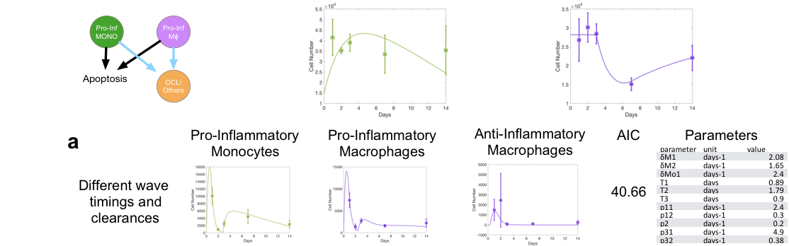
Macrophages and the cancer bone ecosystem
The model An Ordinary Differential Equations (ODEs) multiscale framework describing the cells in the bone ecosystem and the signals that mediate bone homeostasis. The framework is designed to allow for the exploration of novel hypotheses regarding macrophage polarization in the bone.
What is new inside? Whave used a flexible ODE framework to systematically explore novel hypothesis of bone macrophage polarization to uncover new biological hypothesis.
How will this change current practice? Many novel cancer treatments are beginning to take macrophages into consideration but their role and polarization in the bone ecosystem remains unknown yet. Our work allows us to understand how cancers take advantage of this polarization, how treatments impact it and how to better apply treatments to allow for macrophages to hinder tumor progression.
End Users The team is made of modelers, experimentalists and oncologists. In this stage the users are bone biologists and, as model-generated hypothesis are tested. Oncologists delivering treatments to patients with primary and metastatic bone cancers.
David Basanta & Conor Lynch Moffitt Cancer Center
U01CA202958-01 IMAG MSM
Notes:
Top figure shows some of the relevant stages involved in injury repair in the bone that the multiscale model captures. The bottom figure shows an example of hypothesis that our framework allows us to quickly explore and contrast to the experimental data.
To include in NOTES section
define/explain it enough for a non-scientific person to explain to the general public (2-3 sentences): Most biological and mathematical models of cancer neglect the ecosystem in which tumors grow. This is an important omission as this ecosystem determines how the tumor will evolve and how treatments will impact it and influence the emergence of phenotypes that are resistant to the treatments. Multiscale mathematical models can bridge the gap between biological data and clinical needs by incorporating environmental and bone ecological data in a way that allows for hypotheses testing and exploration.
List future challenges or next steps after your project is done (1 sentence): We are currently testing model-generated hypothesis on how existing IFN-Gamma treatments would impact bone recovery after injury. If those are validated we will incorporate emerging data with regards to prostate metastases and explore how macrophage polarization would impact metastatic evolution.
Multiscale modeling: Flow cytometry data is easy to acquire in bone biology but the multiscale processes involved in injury repair and bone homeostasis crucial to explain prostate cancer to bone metastases are hard to elucidate with experimental tools alone. Our ODE framework allows us to efficiently explore many unexplored biological hypothesis connecting various escales of bone biology (molecular and cellular) and contrast model outputs with flow data to determine the most plausible ones. This framework is a highly coupled ODE system ensuring that only a robust approximation to the biological reality will be consistent with the experimental data and that the model predictions will lead to novel experimentally testable hypotheses in regards to treatment.
PI name, email: David Basanta (David.Basanta@Moffitt.org)

Slide 5
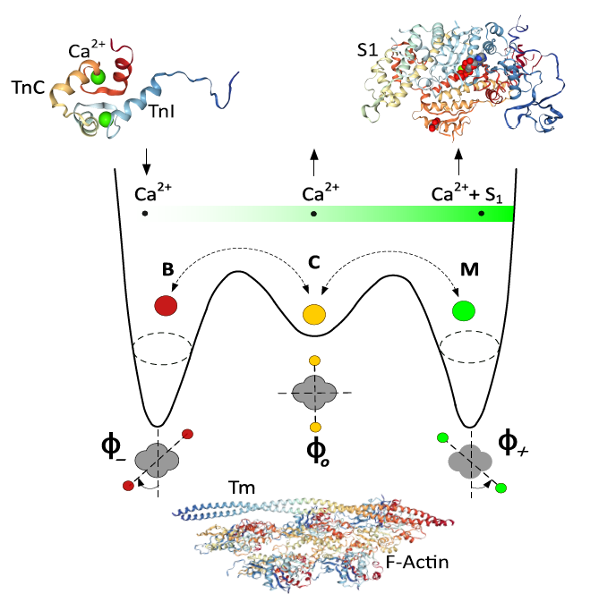
Multi-Scale Modeling of Cardiac Muscle (U01 HL122199, U01 HL126273, U01 HL133360)
Yasser Aboelkassem and Andrew McCulloch, UC San Diego
Objective
To link atomistic molecular models of cardiac contractile proteins to sarcomere scale stochastic models of dynamic calcium dependent cross-bridge cycling, tension development and energetics.
Innovation
New coarse-graining approaches using Brownian and Langevin dynamics are used to bridge scales to elucidate molecular mechanisms of cardiac contractile function.
The model represents the structural arrangement of tropomyosin molecules as a flexible chain and accounts for the spatial interactions among nearest-neighbor regulatory units, which are thought to arise from the structural coupling of adjacent tropomyosin molecules along the thin filament.
The activation of thin filament regulatory units is described by a set of coupled stochastic ordinary differential equations.
Future Work
This approach opens the way for us to make the first multi-scale models of the heart that integrate from molecular to organ system scales. They will be used to address mechanisms of hypertrophic and dilated cardiomyopathies and therapeutic mechanisms of new heart failure therapies.
Aboelkassem et al. 2019:
A New Cardiac Myofilament Model Based on Brownian-Langevin Dynamics.
Pending submission to Biophysical Journal
Investigators: Yasser Aboelkassem and Andrew McCulloch (UC San Diego) PIs: Bassingthwaighte (U. Washington), Clancy (UC Davis), Holmes (UVA)

Slide 6
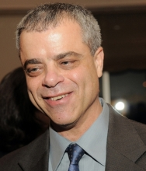

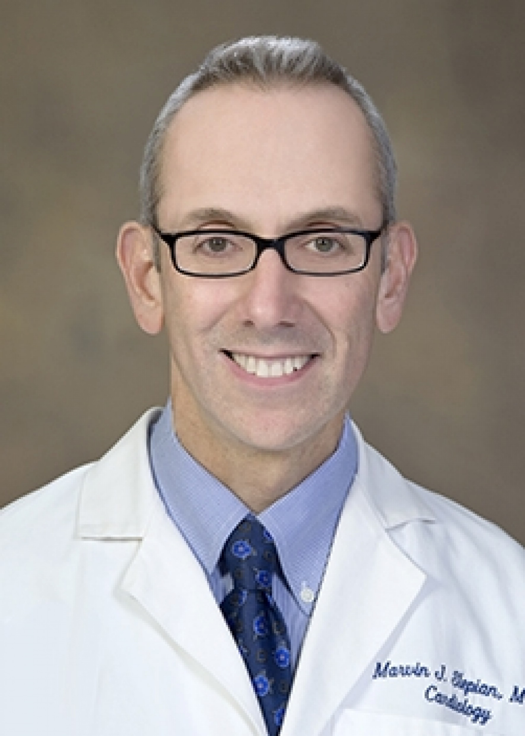
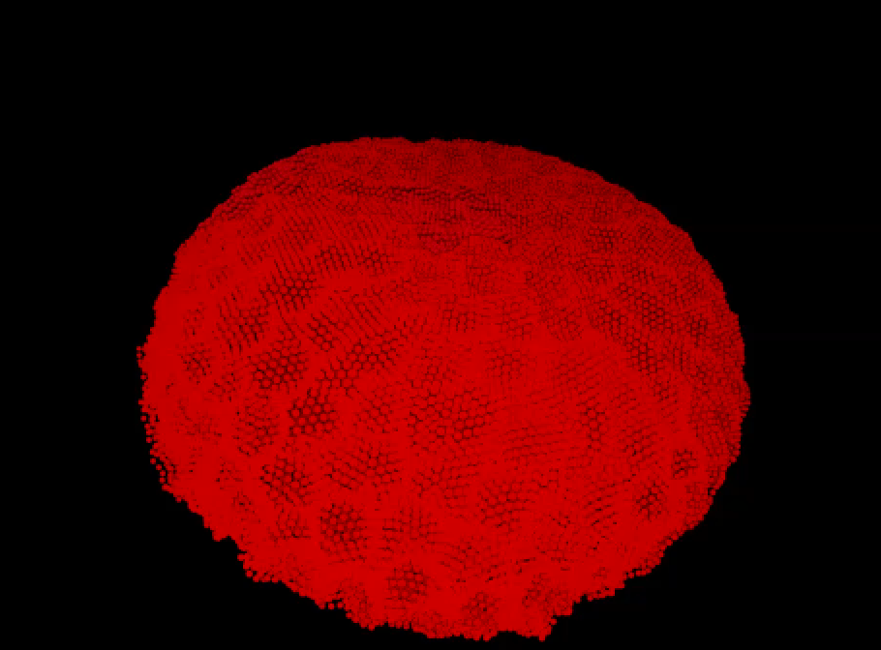
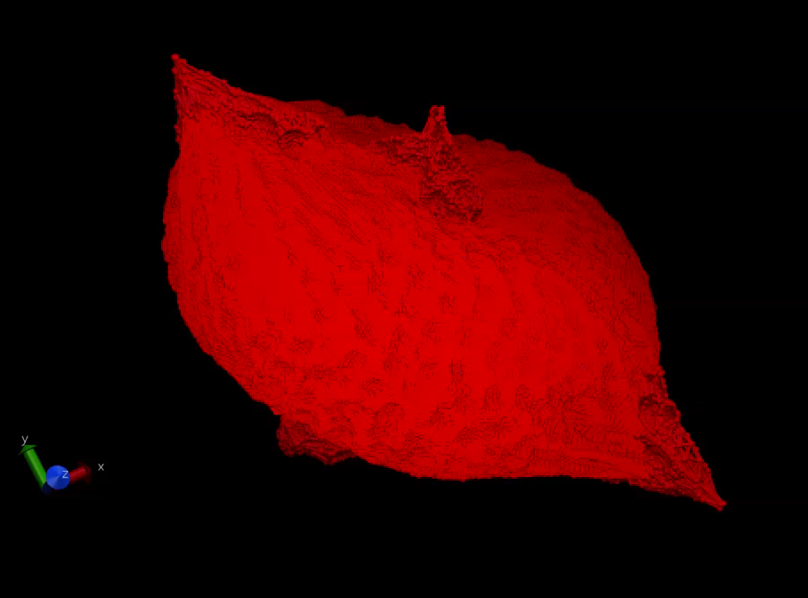
MULTISCALE MODELING OF BLOOD FLOW AND PLATELET MEDIATED THROMBOSIS
The model: We developed a multiscale model for simulating platelet activation, aggregation, and adhesion in viscous blood flow. This model incorporates Dissipative Particle Dynamics (DPD) of viscous flow that interfaces with Coarse Grained Molecular Dynamics (CGMD) of mechanobiology-based platelets to simulate their activation via mechanotransduction pathways, and their aggregation and adhesion to platelets or coagulation proteins deposited onto a blood vessel wall.
Machine Learning methods validate model predictions with in vitro results and
adapt temporal scales to diverse spatial scales for more efficient simulations.
Danny Bluestein
Stony Brook University
Yuefan Deng
Stony Brook University
Marvin J. Slepian
University of Arizona
Funding Support: NHLBI 5 U01 HL131052
What is new inside? Our approach is the first multiscale numerical method for simulating flow-mediated platelet activation, aggregation, and adhesion that includes receptors on the platelet membrane. Biophysical properties of a platelet are accurately described down to a nm-length and ps-time scale, and the viscous flow is described at a μm-length and ns-time scale.
How will this change current practice? Although platelets are less deformable than red blood cells, this work demonstrates that a rigidity assumption typically used for platelet simulations is erroneous. A mechanobiology-based deformable model allows the development of precise predictive models.
End Users The primary stakeholders are clinical and numerical experts in the flow-mediated thrombosis field who will use the model to predict risk of thrombus formation in cardiovascular diseases and devices. This method can be adapted to model a variety of platelet-based diseases by considering mechanical events triggering biochemical responses.
Activated Platelet with 5 Filopods
Notes:
NOTES
The coagulation cascade of blood may be initiated by flow-induced platelet activation and aggregation, which prompts clot formation in prosthetic cardiovascular devices and vascular disease processes. Continuum methods fail to capture subcellular mechanisms such as filopodia formation during platelet activation, while utilizing molecular dynamics is computationally prohibitive. A multiscale approach offers a means to bridge the gap between the diverse scales encompassing subplatelet mechanisms and the surrounding blood flow field.
We employ machine learning to establish a framework to characterize phase changes involved in platelet dynamics for adjusting timestep sizes in simulations, as well as predict physical characteristics of platelet-driven events, such as contact area during aggregation. This intelligent algorithm makes efficient use of limited computing resources and offers a promising insight for solving massive particle-based multiscale problems.
Future goals include the development of a platelet-mediated thrombus growth model under fluid shear stress that will adapt the molecular-scale properties of our current recruitment aggregation and adhesion models, thus predicting macro-scale properties using micro-scale principles.
Multiscale modeling: Our multiple spatiotemporal model employs a modified DPD to describe viscous blood flow in stenoses and microchannels⁵, and electrical-free CGMD to describe the intra-platelet constituents to study the mechanotransduction process². Spatially, the DPD-CGMD is interfaced by imposing a hybrid force field¹. In this spatial interface, the Lennard-Jones term helps maintain the cytoskeleton-confined shape and the incompressibility of platelets against the applied shear stress of circumfluent flow. The dissipative and random terms maintain the local flow thermodynamic and mechanical properties, and exchange momentum to express interactions between the platelet and the flow. Temporally, an event-driven multiple time-stepping (MTS) scheme⁶ is developed as an efficient numeric solver on top supercomputers^{7.}
PI: Danny Bluestein, Danny.Bluestein@stonybrook.edu
REFERENCES
[1] Zhang, P et al., Cell Mol Bioeng, 7:552-574, 2014.
[2] Zhang, P et al., J Biomech, 50:26-33, 2017.
[3] Pothapragada, S et al., Int J Numer Method Biomed Eng, 31:1-16, 2015.
[4] Gupta, P et al., Cell Mol Bioeng, 2019. (under revision)
[5] Gao, C et al., J Comput Phys, 335:812-827, 2017.
[6] Zhang, P et al., J Comput Phys, 284:668-686, 2015.
[7] Zhang, P et al., Comput Phys Commun, 204:132-140, 2015.

Slide 7
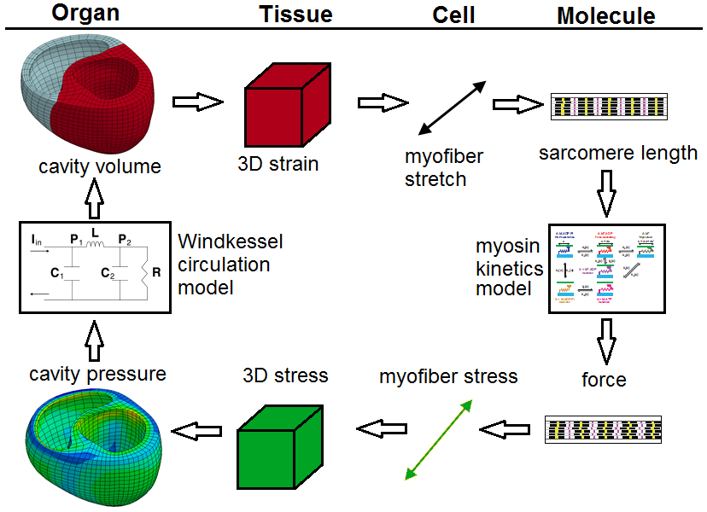
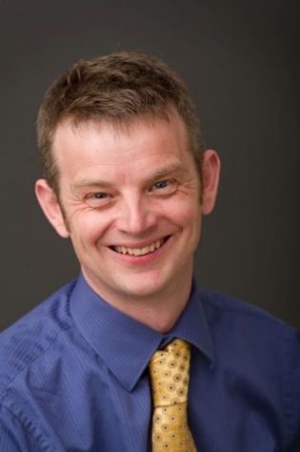

Multiscale Modeling of Inherited Cardiomyopathies and Therapeutic Interventions – NIH U01 HL133359
Objective
To develop and validate a multiscale computational model that can predict how hearts remodel over time in response to genetic or pharmaceutical modulation of myosin function. The modeling will be supported by experiments that measure structure and function at molecular to organ-level scales.
Innovation
The mathematical representation of myosin-level function will include mechanisms that are directly related to genetic mutation and pharmaceutical therapy.
The new growth and remodeling techniques will enable both ventricular structure and function to evolve over a large timescale.
Modular code structure will allow other researchers to enhance the model.
Significance
The new modeling approach could allow more targeted patient-specific treatment plans by testing new small molecule pharmaceuticals in silico.
End Users
Cardiac researchers in the near-term and clinicians in the long-term.
Flowchart of the multiscale model,
showing coupling of data.
Kenneth
Campbell
Jonathan
Wenk
Co-PIs: Kenneth Campbell and Jonathan Wenk (University of Kentucky)
Co-Is: Lik Chuan Lee (Michigan State) and Christopher Yengo (Penn State)
Notes:
Overview: Genetic mutations in the heart can lead to long-term issues, which diminish livelihood. By combining computational simulations and clinical data, new approaches for treatment could be developed that are tailored to each specific patient.
Future Challenges: Translating the model to use clinical data from patients.
PI name, email: Kenneth Campbell (k.s.campbell@uky.edu) and Jonathan Wenk (jonathan.wenk@uky.edu)

Slide 8
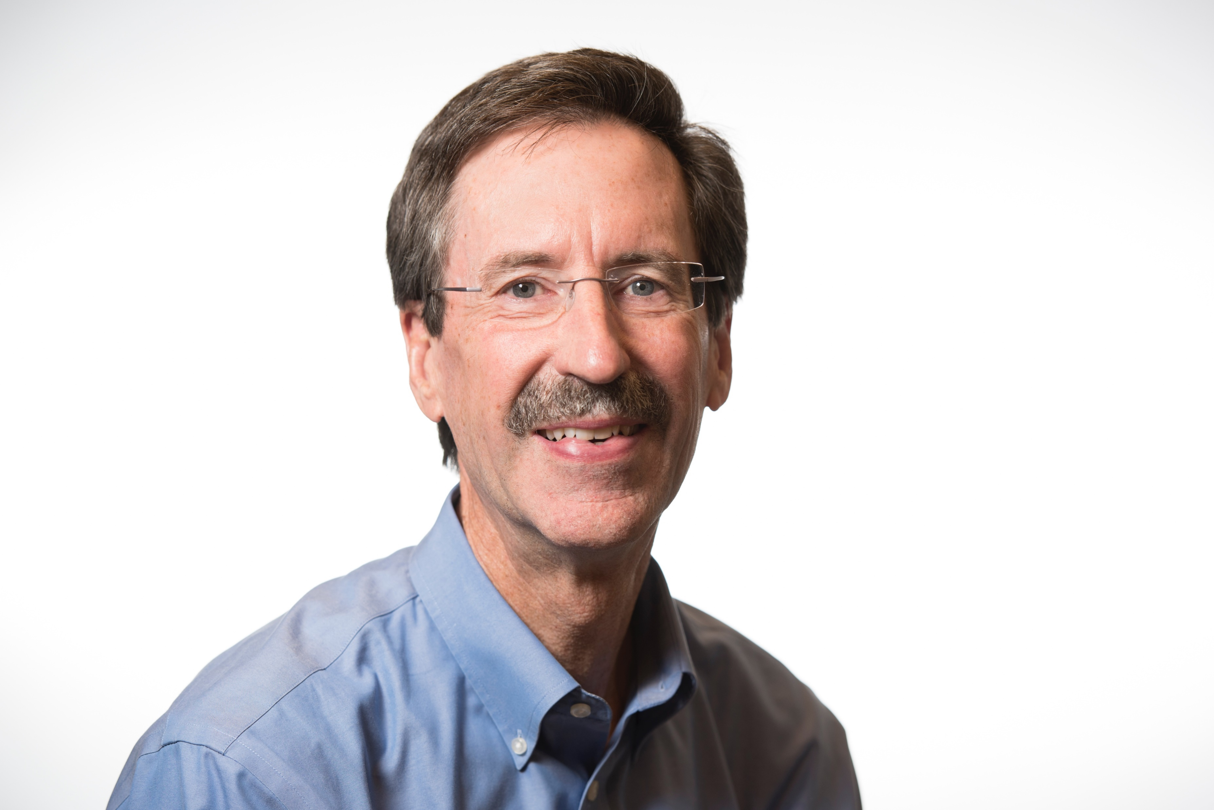
Multiscale Modeling of Circadian Rhythms
The purpose of the model is to model and simulate a cell, especially metabolism, by bringing in more physics than was previously possible and to couple reactions on the millisecond time scale (enzyme kinetics) with the circadian clock that operates on the 24 hour time scale.
What is new inside? A new mathematical approach was developed that combines optimal processes in physics (maximum caliber) with reinforcement learning to infer all necessary rate parameters needed to model metabolism rigorously. After inference of an optimal model, a population of diverse, sub-thermodynamically optimal models, with rate constants, can be easily generated. The circadian clock is modeled on the 24 hour time scale using ODEs, while metabolism can be solved tens of thousands of times during the circadian cycle using optimization methods.
How will this change current practice? Currently, thermodynamics and kinetics are usually ignored when using traditional constraint-based flux modeling such as flux balance analysis. The new method rigorously models thermodynamics and kinetics, and is scalable beyond metabolism to look at protein production as well. The new optimization methods ensures that these methods will be fast and scalable.
End Users The methods can be applied to any system, for instance to study differentiation in stem cells. The platform is open source, coded in python, and metabolomics and proteomics data are useful but not required.
William Cannon, Pacific NW Nat. Lab
Jay Dunlap, Dartmouth
NIBIB, U01EB022546
Notes:
Public statement: A new mathematical approach has been developed that combines our ability to define optimal processes in physics with machine learning to infer all necessary rate parameters needed to rigorously model metabolism. After inference of the optimal model, diverse models representing the metabolisms that would be present in a population can be easily generated. The circadian operation of the cell is modeled on the 24 hour time scale along with metabolism which occurs on the millisecond time scale.
Machine learning, specifically reinforcement learning, is used to learn how regulation should be applied to metabolism. The reinforcement learning algorithm uses metabolomics data, but highly accurate data is not needed. Further advances that combine predictive simulations with reinforcement learning will enable us to go beyond metabolism and model protein and enzyme production rigorously, as well.
Future challenges are (1) to map these activities and dynamics to mesoscale structures of the cell obtained from imaging studies, and (2) to scale these physics-based methods up from metabolism to protein synthesis and then gene expression. Going from metabolism to proteins to genes – a bottom up approach – allows us to propagate the physics from one scale up to another by a series in which we model the lower scale, average over and parameterize the dynamics, and then model the next higher scale.
Multiscale modeling: The multiscale challenge is being addressed in a manner analogous to operator splitting, in which two time scales can be separated if one time scale reaches a quasi-steady state rapidly compared to the slower time scale. In our approach, ODEs are used to simulate the circadian clock regulation and proteins, while very fast non-linear optimization methods are used to solve the time dependent equations for the kinetics of metabolism.
Medical simulation: The math challenge being overcome is how to model metabolism rigorously when both in vitro and in vivo rate parameters are extremely difficult to determine experimentally. We overcome this problem by (1) using a new constrained optimization approach to obtain the non-equilibrium, steady state, maximum entropy distribution of metabolism, (2) the predicted metabolite concentrations are compared to those generally expected from experiment using a loss function from which post-translational regulation of enzymes is inferred, (3) the system is re-optimized with the inferred regulation from which rate constants are determined from the metabolite concentrations and reaction fluxes, and finally (4) a full ODE-based, mass action simulation with rate parameters and allosteric regulation is obtained.
Analysis: What makes it possible to infer mechanism using this approach is that the same physical principles are used to formulate the math used in both the simulations and the data analysis methods present in the reinforcement learning implementation. The statistical method is statistical thermodynamics, which is also a multinomial likelihood model used to analyze the data.
Interestingly, the metaphor for self-organizing systems being used in this project – dissipative structures – is also being used in Europe to study and elucidate how the brain works.

Slide 9
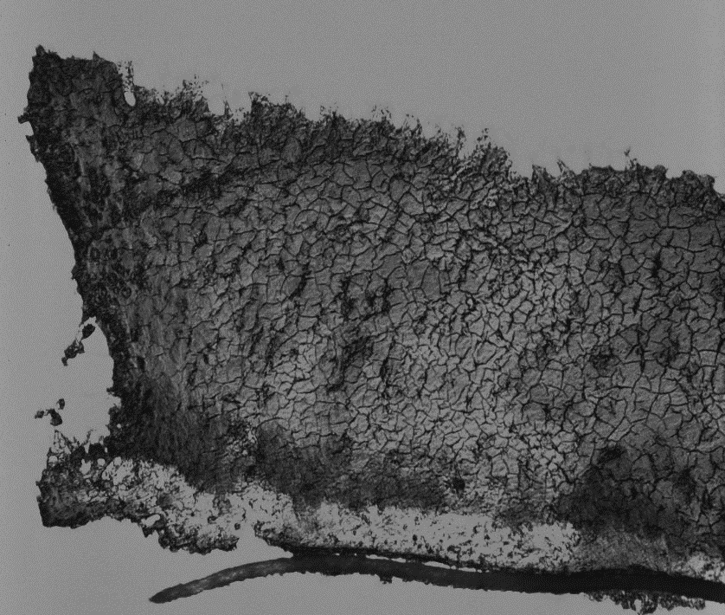

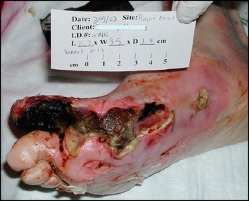

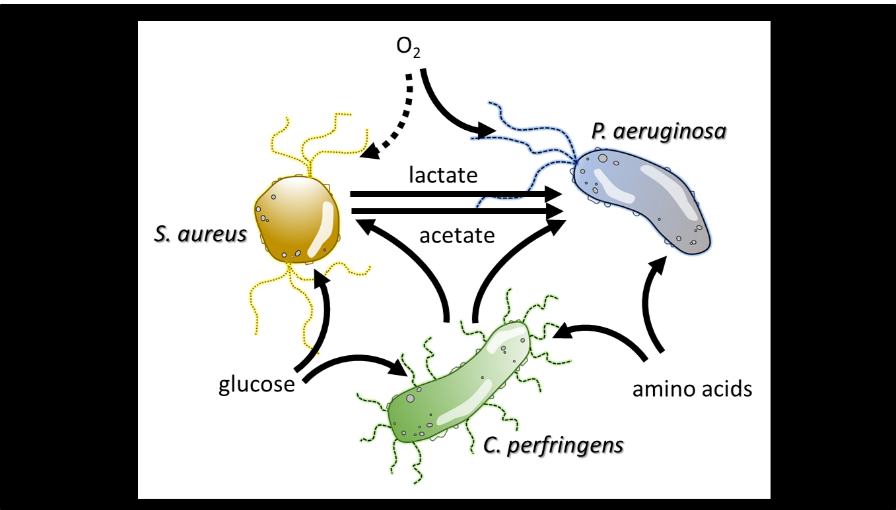
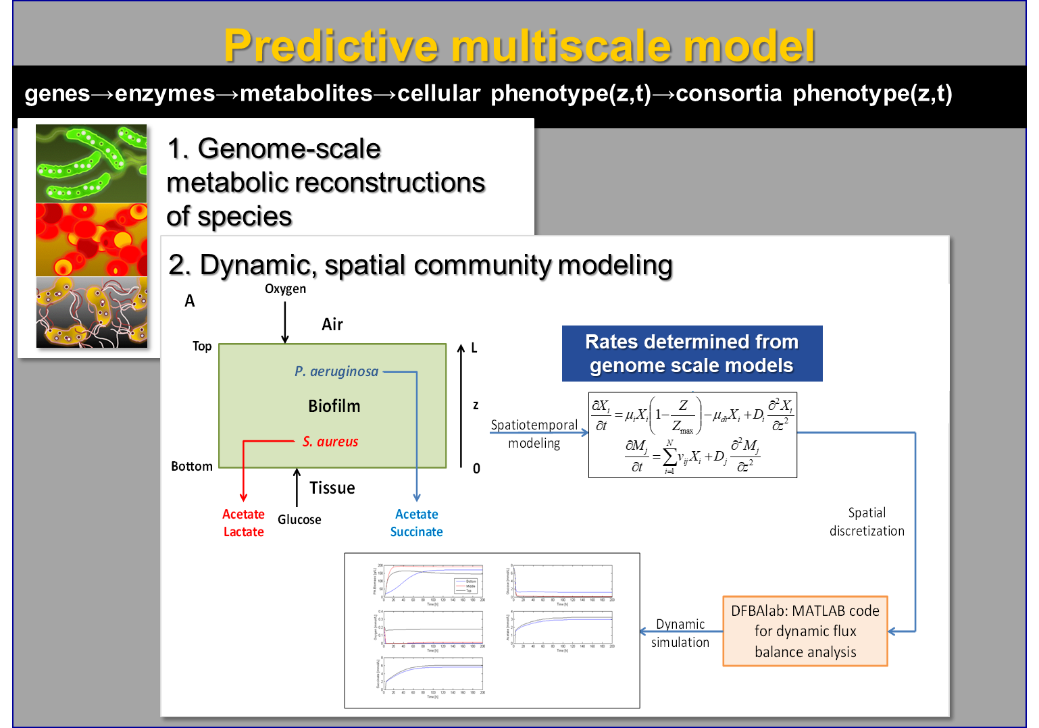
Predictive Multiscale Modeling of Chronic Wound Biofilms
NIH NIBIB U01EB019416
Ross P. Carlson, Michael Henson, Luke Hanley, Matthew Fields
Montana State University, UMass, Amherst, University of Illinois, Chicago
Chronic wounds are categorized as nonhealing wounds that do not proceed through resolution within ~3 months. Chronic wounds impact over 8 million US patients and cost an estimated $30-60 billion in healthcare costs annually. Chronic wounds are challenging to treat using traditional antibiotics because they are typically colonized by interacting consortia growing as recalcitrant biofilms.
In vitro and in silico pathogen consortia
The Model quantifies the complex spatial and temporal dynamics of biofilm consortia. The wound pathogens are represented using genome-scale, metabolic reconstructions; phenotypes are predicted using linear programming (LP) optimization methods. Pathogen metabolic models are imbedded in a discretized control volume where mass balances are enforced using partial differential equations which account for pathogen reaction and metabolite diffusion processes.
What is new and how will this change current practice? The models enable multiscale, spatially and temporally resolved predictions of pathogen behavior in chronic wounds. The pathogen phenotype problem is solved using novel lexicographic LP optimization algorithms to account for alternative and infeasible optima. The methodology will eventually enable personalized medicine where metagenomic data from a patient’s wound will inform an in silico wound model for optimizing treatment.
End users of the model will be scientists informing clinicians on wound treatment strategies. Ultimately this technology will enable personalized medicine where models tailored to specific patient chronic wound composition can be fed into an in silico model and used to predict optimized treatment strategies.
Key Publications: Phalak et al., 2016 doi.org/10.1186/s12918-016-0334-8
Carlson et al., 2018 doi: 10.1042/BST20170242
Henson and Phalak, 2018 doi.org/10.1371/journal.pcbi.1006558
Notes:
Chronic wounds are categorized as nonhealing wounds that do not proceed through resolution within a standard time period. Nonhealing, chronic wounds impact over eight million US patients and cost an estimated 30-60 billion USD in healthcare costs annually. We have built computational and experimental tools to analyze the complex interactions between chronic wound microorganisms and local environments so therapeutic strategies can be optimized.
Computational models require parameters which can be difficult to extract from complex experimental data sets. Machine learning and AI will facilitate the identification of meaningful model parameters through the analysis of large, multicondition biofilm growth data sets.
We have developed a suite of computational tools that predict interactions and emergent properties of biofilm pathogens with spatial and temporal resolution; we have also developed new experimental methodologies including a new biofilm reactor, to make spatial and temporal measurements of biofilm growth. A major challenge will be integrating the full range of computational and experimental methodologies which are measured and predicted on different size and time scales.
Multiscale modeling: Biofilms as inherently modular and multiphasic with multiple species of bacteria embedded in a polymer hydrogel, exchanging chemicals across aqueous intercellular spaces, while interacting with local physical environments. The modeling methodology addresses these challenges by embedding genome scale metabolic models for individual species within a partial differential equation model quantifying the aqueous phase chemicals. The approach integrates biotic chemical reactions with abiotic diffusion processes.
Ross P Carlson, rossc@montana.edu

Slide 10
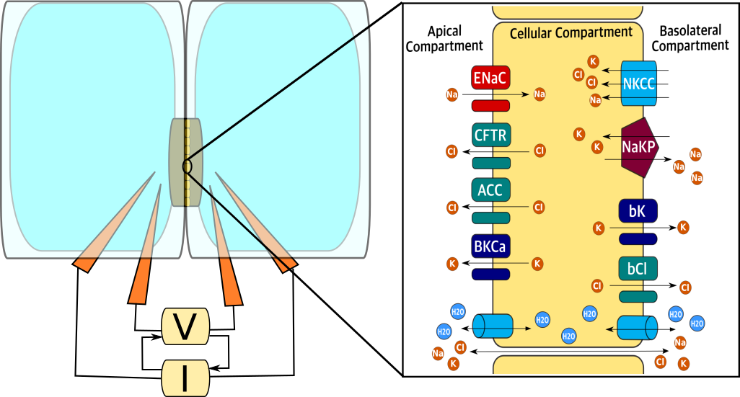
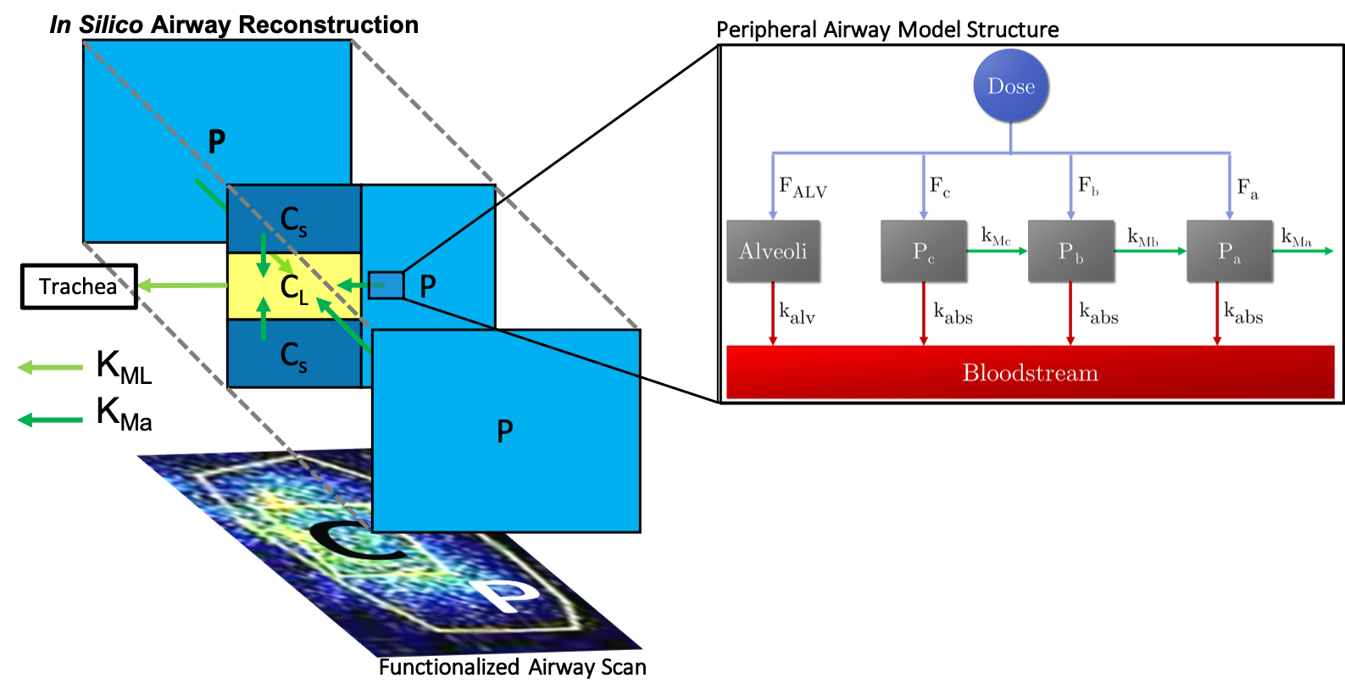
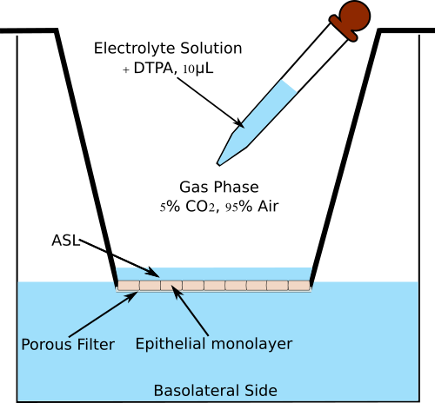
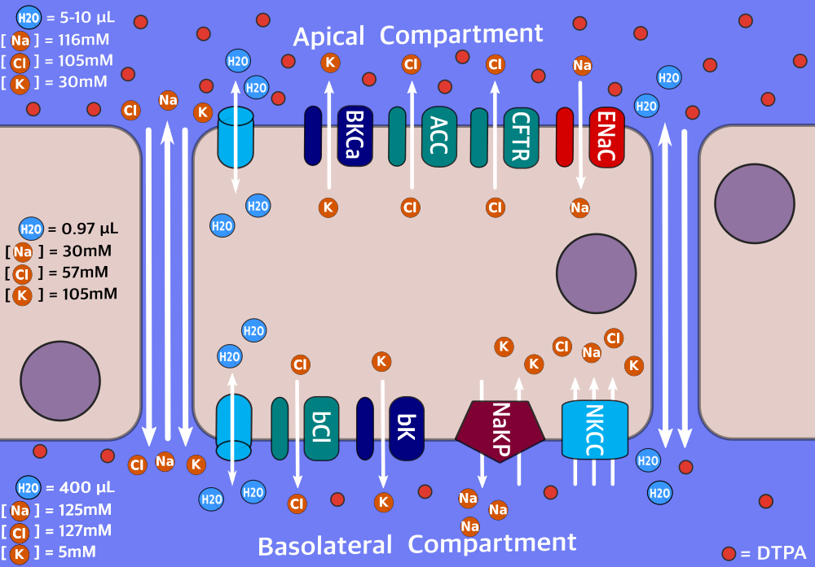
Multi-Scale Mathematical Models of Airway Physiology to Facilitate Cystic Fibrosis Treatment Design
Modular, biophysically-inspired models can help elucidate Cystic Fibrosis (CF) airway pathophysiology across multiple scales and provide a bridge from the benchtop to the clinic
What is new inside? Donor-matched in vitro, in vivo and clinical endpoint measurements are used to independently inform models at distinct physiological scales. Models employ multiple algorithmic tools in order to satisfy physical and biological constraints (pathway boundaries, multidimensional nonlinear optimization) while guaranteeing mathematical robustness and versatility (parameter identifiability and constraint feasibility analysis).
How will this change current practice? Improves understanding of CF pathogenesis and the physiological differences between healthy subjects, carriers, and CF patients; facilitates the design of therapies that address the variety of disease manifestation observed among CF patients; speeds up the characterization and validation of novel disease models.
End Users? Researchers looking to expedite hypothesis generation and testing; Clinicians in
order to design and test phenotype-specific treatment regimens. Once validated, common in vitro
assays will be used to generate in silico descriptors that can predict a patient’s therapeutic response.
Water and solute transport rates
Tissue Scale
Thin Film Dynamics: Liquid and
Small Molecule Transport Model
Organ Scale
Airway Scans: Mucociliary
Clearance and Absorption Model
Cell-Scale
Ussing Chamber: Epithelial Electrophysiology Model
Ionic permeabilities and fluxes
Timothy E. Corcoran, Ph.D. and Robert S. Parker, Ph.D.
University of Pittsburgh
U01 HL131046-01
Notes:
This project aims to develop a platform that uses patient-specific models at the systems and cell scale(s) to conduct in silico assessments of possible treatment strategies to promote airway function in patients with Cystic Fibrosis. An example of a present therapy is inhaled hypertonic saline, which is not very durable. Our multi-scale models, calibrated against inhaled normal and hyperosmotic saline, can be used to design an inhalation protocol to target normal hydration levels for CF patients, based on models calibrated to individual patients. Furthermore, we are testing the model with other hyperosmotic therapies (e.g., inhaled mannitol) to assess durability of action and decrease the burden of repeated treatments.
Machine Learning techniques, in particular clustering algorithms (e.g. kNN, semi-supervised learning), could be used to facilitate the generation of model-based parametric groups that corresponds to clinically-different phenotypic manifestation of CF.
A future challenge for this project is to mathematically describe the spatiotemporal nature of lung function, while also being tied to a functional/clinical readout that could differentiate healthy and diseased individuals, potentially allowing endo/phenotyping of the diseased population into subpopulations based on model-captured differences.
Multiscale Modeling: The development of the models has followed a modular approach. Donor-matched datasets from healthy donors, parents of CF patients (carriers), and CF patients have been used to inform
Physiologically-inspired models at the cell, tissue and organ levels. The dataset was designed such that information most relevant at physiological scale would inform the corresponding model. Thus we provide a robust methodology to extrapolate model predictions from one level to the next. With this approach, we intend to bridge Cystic Fibrosis (CF) associated cell-level ion channel malfunction to the individual and population functional assessment of mucociliary clearance (MCC) from the whole lung.

Slide 11


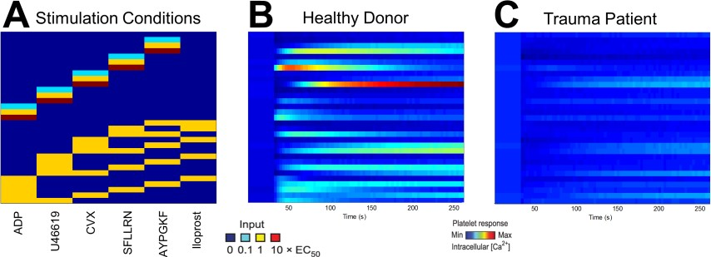
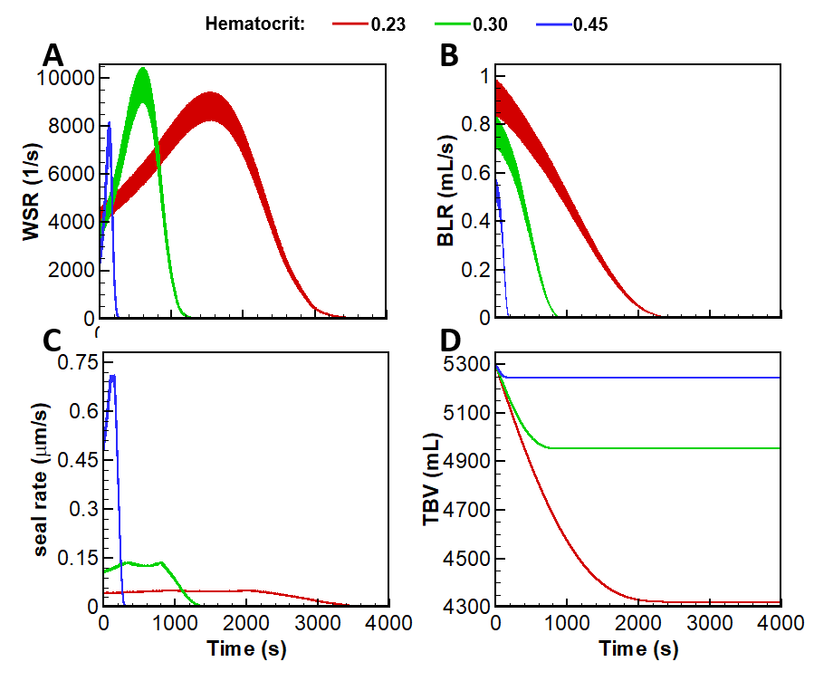
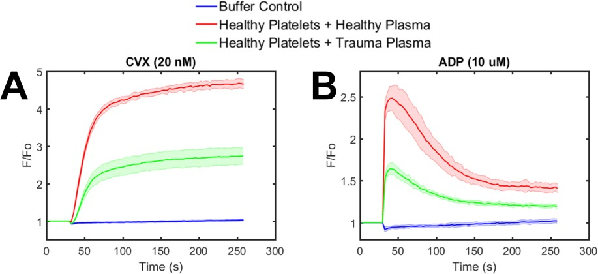
Multiscale Analysis of Trauma
Evan Tsiklidis¹, Christopher Verni¹, Yannis Kevrekidis², Carrie Sims³, Talid Sinno¹, Scott L. Diamond¹
¹Chemical and Biomolecular Engineering (Penn), ²Chemical
Engineering (Princeton), ³Dept. of Trauma Surgery (Penn)
The model: The overall goal is to quantify metabolic responses to trauma, predict responses to physiological perturbations, and develop “on‐the‐fly” patient‐specific strategies. This is done via experiment, whereby trauma patient blood is acquired at marked time‐intervals post‐injury to better stratify patient bleeding risks, prioritize biomarkers, and identify new opportunities for safer treatment options. This is also done via simulation where a multiscale model that accounts for changes in systemic circulation is linked to cellular responses to hemostasis over 6 orders of magnitude. The model consists of a global hemodynamic (GH) submodule that is represented as a closed‐loop hydraulic circuit that includes 0‐D, descriptions of the various components of the body, a bleeding branched vascular network (BVN) with a random distribution of cuts, and the single vessel scale for clot simulation. The global hemodynamic model includes the baroreflex response for modulating cardiovascular output. At all scales, models are constructed to match physiological conditions (B) before a wound occurs and the simulation predicts the expected outcome upon injury (C).
Grant support: NIH U01‐HL‐131053
Inner‐working Math: GH module consists of multiple, interacting 0‐ dimensional arterial and venous compartments arranged in series and parallel elastic pulsatile description of heart, and baroreflex control. Solved by system of ODE’s.
BVN module solves for pressure, flow, and shear distribution through the BVN via a modified Poiseuille flow equation.
Models coupled together via conservation of mass and momentum.
Change Current Practice: Important implications regarding resuscitation and transfusion strategies, i.e. effects of hemodilution.
End Users: Trauma surgeons, use to guide decision‐making.

Slide 12
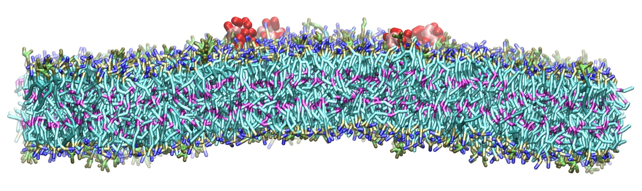
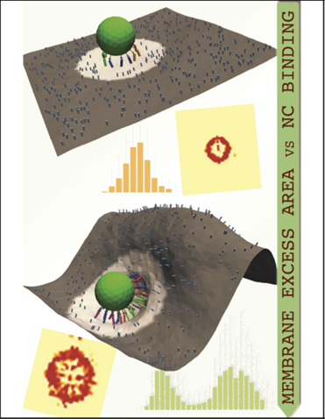
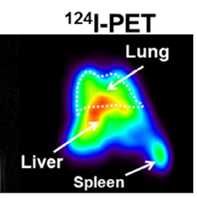
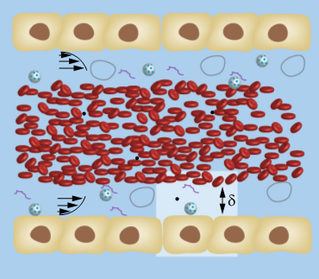
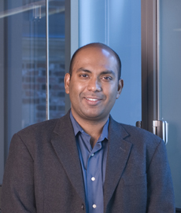
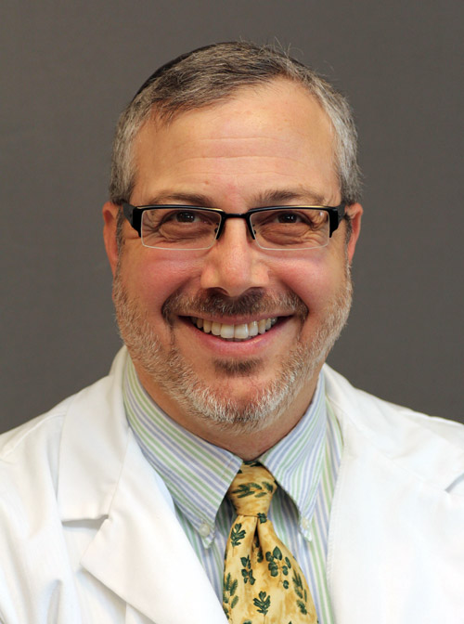
Multiscale Modeling in Nanomedicine and Quantitative Systems Pharmacology
The model. Multiscale model for nanocarrier (NC) design, transport, and adhesion for vascular targeted drug delivery applications
What is new inside? The model combines and bridges robust techniques of molecular simulations and enhanced sampling at the molecular scale with continuum hydrodynamics at the tissue and organ scale. Multiscale bridging is achieved through the use of novel algorithms based on stochastic transport equations (generalized Langevin equations and Brownian dynamics), field theory (dynamical density functional theory, thin shell elasticity), and equilibrium statistical mechanics (Monte Carlo simulations). Model validated using in vitro (cellular constructs in flow), in vivo (murine and equine systems), and physical science (atomic force microscopy, quartz microbalance, ektacytometry) experiments at multiple scales.
How will this change current practice? Current design of nanocarriers utilizes empirical design approach through exhaustive experimentation often involving animals. The multiscale model offers a route to rational design and insight into mechanisms and can be used in streamlining animal experiments in the design of rigid and flexible nanocarriers for efficacious therapeutic delivery.
End Users. The algorithms are implemented using best practices in software architecture in a heterogeneously coupled multiscale framework using process workflow management software, virtual environments, and pipeline for heterogeneous systems. They will be made available through private and general purpose cloud.
Molecular scale models
NC adhesion to live cells
NC margination
In vivo imaging
Radhakrishnan, UPenn
Eckmann, UPenn
Grant: NIBIB, U01EB016027
Notes:
David M. Eckmann, email: David.Eckmann@uphs.upenn.edu
Ravi Radhakrishnan, email: rradhak@seas.upenn.edu
To include in NOTES section
Project Narrative: Nanocarrier based imaging and drug delivery systems for systemic (e.g., intravenous) therapeutic and diagnostic applications are inherently complex. We are tightly coupling in vivo experimentation (mouse and
horse models and human blood sample and imaging analysis) with multiscale numerical methods to validate, predict,
and guide precision in clinical nanoparticle use by developing a computational Predictive Mechanism Based
Nanoparticle Targeting (PMBNPT) model for medical nanocarrier applications.
Nanoscale adhesion: Biophysically inspired model for functionalized nanocarrier adhesion to cell surface: roles of protein expression and mechanical factors, N. Ramakrishnan, D. M. Eckmann, V. M. Muzykantov, P. S. Ayyaswamy, and R. Radhakrishnan, 2016, Royal Society Open Science, 2016, 3, 160260. DOI: 10.1098/rsos.160260;
Nanoscale Transport: Motion of a nanospheroid in a cylindrical vessel flow: Brownian and hydrodynamic interactions, N. Ramakrishnan§, Y. Wang§, D. M. Eckmann, P. S. Ayyaswamy, R. Radhakrishnan, Journal of Fluid Mechanics, 2017, 121, 117-152; DOI: 10.1017/jfm.2017.182;
Molecular scale coupling: Multivalent binding of a ligand coated particle: Role of shape, size and ligand heterogeneity, M. McKenzie, S. M. Ha, A. Rammohan, R. Radhakrishnan, and N. Ramakrishnan, 2018, Biophysical Journal, 114(8):1830-1846. DOI: 10.1016/j.bpj.2018.03.007;
Coupling nanoscale transport and adhesion: Effect of wall-mediated hydrodynamics on the kinetics of activated processes for a Brownian particle predicted using composite generalized Langevin equations, H.-Y. Yu, D. M. Eckmann, P. S. Ayyaswamy, R. Radhakrishnan, Proceedings of the Royal Society A, 2016, 472, 20160397. DOI: 10.1098/rspa.2016.0397;
Multiscale validation with experiments: A Computational Model for Nanocarrier Binding to Endothelium Validated Using In Vivo, In Vitro, and Atomic Force Microscopy Experiments, J. Liu, G. E. R. Weller, B. Zern, P. S. Ayyaswamy, D. M. Eckmann, V. Muzykantov, R. Radhakrishnan, Proceedings of the National Academy of Sciences, 107(38), 16530-16535, 2010. Pubmed ID: 20823256;
Role of machine learning and AI: In silico profiling of activating mutations in cancer, E. Jordan, K. Patil, K. Suresh, J. Park, Y. Mosse, M. A. Lemmon, R. Radhakrishnan, 2019, in review at Cellular and Molecular Living Systems;
Future challenges: Assembling, curating and hosting the multiscale software using best practices in software architecture and high-performance computing and disseminating on the cloud.

Slide 13
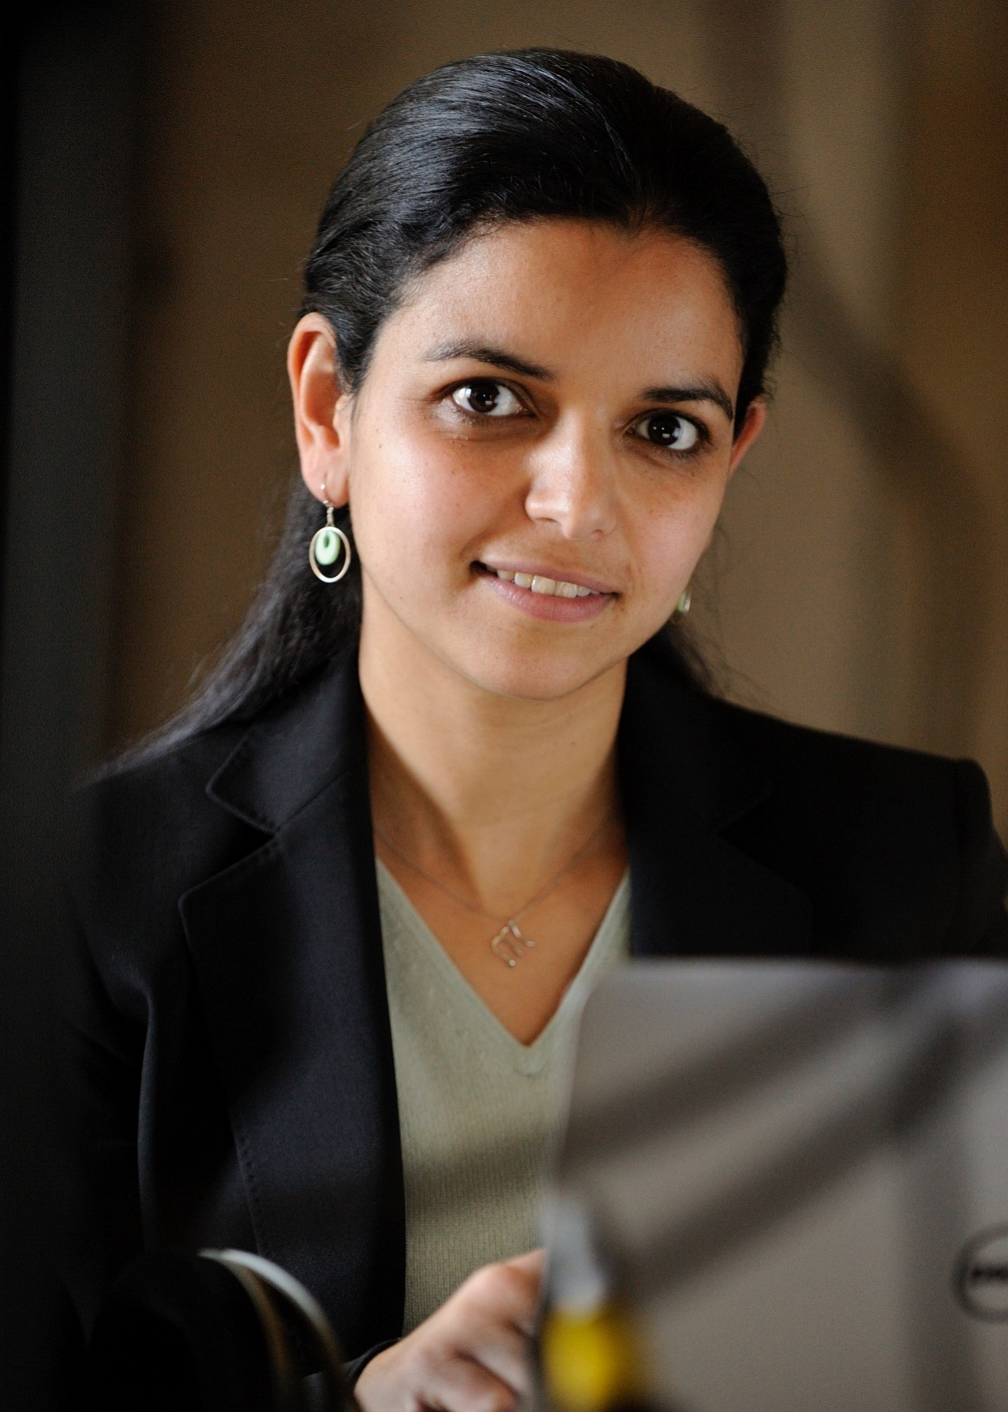
Multiscale modeling of the cocktail party problem
The model: The project develops a dynamical system with
Bayesian statistics to understand mechanisms of auditory scene analysis,
i.e. the brain’s ability to make sense of multitude of sounds that surround us
in everyday life. The model performs a hierarchical inference that encodes auditory scenes
over varying time scales; and mimics brain networks across multiple scales (from single neurons
to cross-loci interactions). Central to this system is the role of cognitive control particularly attentional and memory feedback that shape the sensory representation in the auditory system, via mechanisms of rapid neural plasticity.
What is new inside? The system investigates the role of neural plasticity, as a form of multiscale working memory. In addition, the hierarchical inference framework allows to examine the interplay of sensory and cognitive factors. The modeling effort is closely informed by experimental results both in human listeners and behaving animal model. Model predictions are validated against brain responses at multiple scales, from single neurons to multi-state brain networks.
How will this change current practice? While the problem of auditory scene analysis is very much centered around sensory information (sounds that enter our ear), it invokes brain processes that extend beyond
sensory networks and invokes constructs of memory and attention. Understanding the role of
these cognitive factors can shape how we understand hearing difficulties of special populations
(aging, hearing impaired) as well as how we build novel state-of-the-art sound technologies.
End Users : Computational simulations are provided as open platforms that can be used by
Neuroscientists and audio technology engineers. All tools can be easily adopted as testbeds or front-
end for other systems with broad health and commercial applications focused on sound technologies.
Mounya Elhilali
Johns Hopkins U.
Shihab Shamma
U. Maryland
U01AG058532
National Institute on Aging
Notes:
Notes:
The project explores the neural underpinnings of the so-called cocktail party problem, i.e. the ability of our brain to make sense of multiple sounds that surrounds us in everyday life. Specifically, we develop multiscale models that explore the interaction between brain networks at multiple scales (from single neurons to cross-loci interactions), closely informed by experimental results in human and animal models. The framework offers a springboard to understand how complex soundscapes are parsed into mentally-distinct constructs. As such, it offers a natural front-end to machine learning systems that can infer further knowledge from these separated mental constructs.
The project is closely informed and directly validated against brain recordings both in awake behaving animals (auditory and frontal cortical networks) as well as in electroencephalograhical recordings from human listeners. This data provides a multiscale outlook on interactions across brain networks which directly maps to the multiscale formulation of the model.
- Chakrabarty, D. & Elhilali, M (2019) A Gestalt inference model for auditory scene segregation. PLOS Computational Biology, 15(1):e1006711.
- Elgueda D, Duque D, Radtke-Schuller S, Yin P, David SV, Shamma SA, Fritz JB (2019) State-dependent encoding of sound and behavioral meaning in a tertiary region of the ferret auditory cortex. Nature Neuroscience, 10.1038/s41593-018-0317-8.
Mounya Elhilali, Johns Hopkins University (mounya@jhu.edu)
Shihab Shamma, University of Maryland (sas@umd.edu)

Slide 14
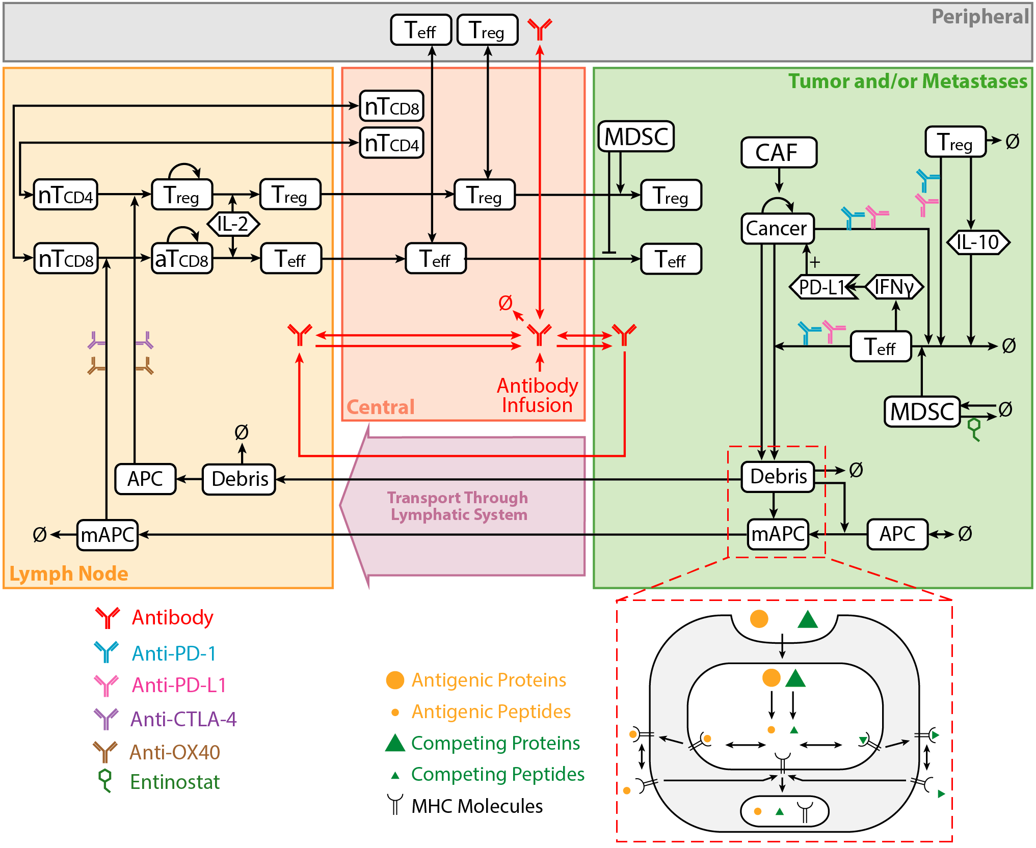
Integrating Bioinformatics in Multiscale Models of Hepatocellular Carcinoma U01CA212007
How will this change current practice?
The multiscale model will be the first to predict response for combination therapies for liver cancer, addressing the dire and unmet need to improve treatment.
End Users Researchers investigating new immuno-, targeted and combination therapies can use our platform to run virtual clinical trials and test new hypotheses through computer simulations.
The model A hybrid Quantitative Systems Pharmacology (QSP) model informed by the bioinformatically processed high-throughput molecular data, in-vitro organoids, animal models, and clinical data to predict the outcome of immuno- and targeted therapies in hepatocellular carcinoma
What is new inside? This project uses new computational techniques to incorporate intra- and intercellular signaling learned from bioinformatics analysis in innovative mathematical models spanning molecular, cellular, tumor, and organ scales.
MPI: Elana J Fertig, PhD
Aleksander S. Popel, PhD
Andrew J Ewald, PhD
Phuoc T Tran, MD
The Johns Hopkins School of Medicine
U01CA212007
Notes:
Instructions:
Submit 1 slide by COB Monday 2/25/19
Title - headline your theory-driven, mechanistic model
name the specific mathematical or statistical method and variations thereof
The model {describe purpose of model or method, describe construct, insert graphical depiction, video of simulation if applicable}
What is new inside? {describe new math, new algorithm}
How will this change current practice?
{Why is this important?}
End Users {Who are the stakeholders? What expertise should they have? How will they use it (e.g.: data & platform needed)?}
To include in NOTES section
define/explain it enough for a non-scientific person to explain to the general public (2-3 sentences)
Our mathematical model simulates the body’s immune cell interactions with cancer cells to predict how cancer will respond to various therapies, including immuno-therapy and small-molecule targeted therapies. We can then generate a large number of simulated patients (virtual patients) by varying the parameters in the model and simulate a clinical trial to test new therapies. This approach is less expensive are does not require the long approval process of a real clinical trial.
mention how can machine learning and AI help your project (2 sentences)
List future challenges or next steps after your project is done (1 sentence)
Our model contains a large set of parameters, many of them can be measured experimentally, or inferred through bioinformatics analysis, however, some of the parameter must be estimated based on the global behavior of the model.
Further details for Notes section - For the following communities (2 sentences):
Multiscale modeling: explain how the math will address methodological challenges (e.g.: crossing scales, sparse data, uncertainty, modularity, spatiotemporal simulation challenges, etc.)
To address parameter uncertainty, we generate a large number of virtual patients by varying the parameters in a physiological range (discarding virtual patients that result in unrealistic model outputs). From this type of analysis, we can determine the parameters to which the model is most sensitive.
PI name, email: Elana Fertig, ejfertig@jhmi.edu

Slide 15
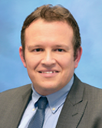
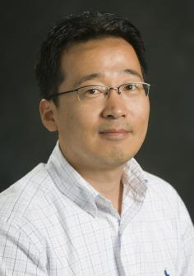
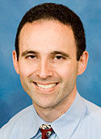
Spatiotemporal Multiscale Model for Cardio-Pulmonary Hemodynamics and Growth and Remodeling
The model
The main purpose of the model is to describe biomechanics of the Pulmonary Arterial Hypertension (PAH) progression. We are developing the spatiotemporal multiscale model of the cardio-pulmonary system (with small, large vasculature and the heart) that accounts for both hemodynamics and tissue growth and remodeling (G&R) using longitudinal clinical human data.
The computational hemodynamics and vessels/heart wall mechanics is implemented with the Coupled Momentum Method (FEM-based FSI) and FEM, respectively. The G&R for vessels walls is described by the constrained mixture theory while for the heart by the growth-tensor. The Fluid-Solid-Growth (FSG) model is described by the temporal multiscale based on time scales separations and linear approximations. The
What is new inside?
Temporal multiscale framework for the FSG model that couples short-time hemodynamics with slow-time G&R of vessels walls in the small pulmonary arterial tree.
Homeostatic optimization of the hemodynamics and wall mechanics parameters accounting for the wall metabolic cost to determine a hemostatic baseline in the arterial tree.
Uncertainty quantification for multi-fidelity models based on statistics and the co-kringing estimator.
How will this change current practice?
This model will interconnect the hemodynamics factors with considerations of G&R observed in pulmonary vessels and right ventricle during progression of PAH. The computational framework will be used for patient-specific modeling and will help in analyzing a biomechanical response of the cardio-pulmonary system to potentially new medical treatments (e.g. vasodilatory agents).
End Users
End product is the computational tool to assist biomechanical engineers, medical scientists and clinicians to investigate the role of hemodynamics and G&R in PAH. The modeling expertize will be required for an engineer as well as a close collaboration with clinicians.
C.A.Figueroa, S.Baek, A.L.Dorfman
Grant NIBIB: U01 HL 135842
Notes:
Instructions:
Submit 1 slide by COB Monday 2/25/19
Title - headline your theory-driven, mechanistic model
name the specific mathematical or statistical method and variations thereof
To include in NOTES section
The multiscale computational framework will be developed to model blood flow and changes in the heart and vessels wall mechanics that are observed in the pulmonary arterial hypertension disease. The model will incorporate the high and low resolution of the small and large vasculature and the heart that are key components of the described cardio-pulmonary system. In the long term, the model will assist with patient stratification based on biomechanical markers, and provide a framework for virtual testing of pharmacological interventions.
We will use machine learning and AI by (1) data assimilation for hemodynamics, (2) uncertainty quantification for multi-fidelity models, (3) uncertainty quantification for parameters evaluated by patients data.
Future challenges consist of (1) full and optimized coupling of the hemodynamics and G&R in small, large vessels and the heart to build unified spatiotemporal multiscale computational tool, (2) automating parameters calibrations, (3) applying the computational model for virtual testing of pharmacological treatments.
Further details for Notes section:
Multiscale modeling: Mathematical framework will help to cross time and spatial scales in a rigorous and consistent way leading to a reliable computational model as well as clarification of the imposed assumptions. This theoretical description will also help to identify numerous model limitations that is usually challenging for the complex multi-physics problem with vascular hemodynamics, G&R, tissues mechanics, and the heart model.
PI : C. Alberto Figueroa (figueroc@med.umich.edu), Seungik Baek (sbaek@egr.msu.edu), Adam L. Dorfman (adamdorf@med.umich.edu)

Slide 16
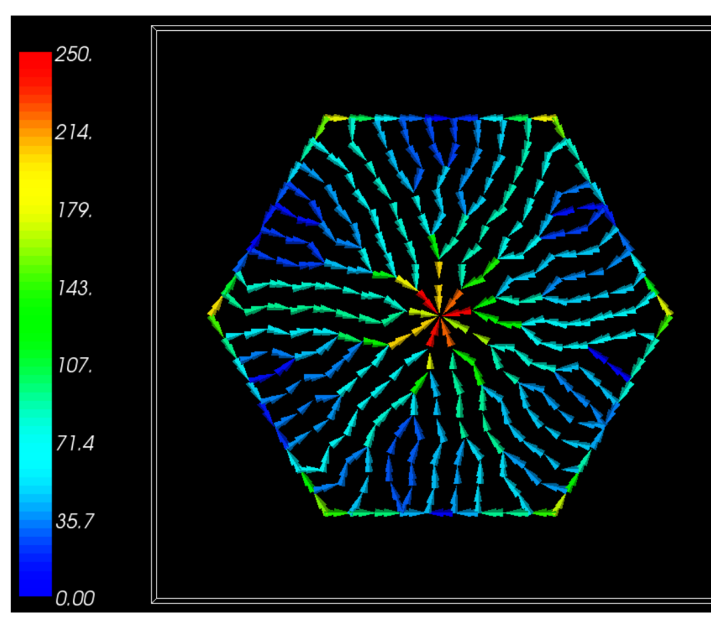
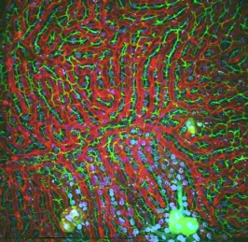
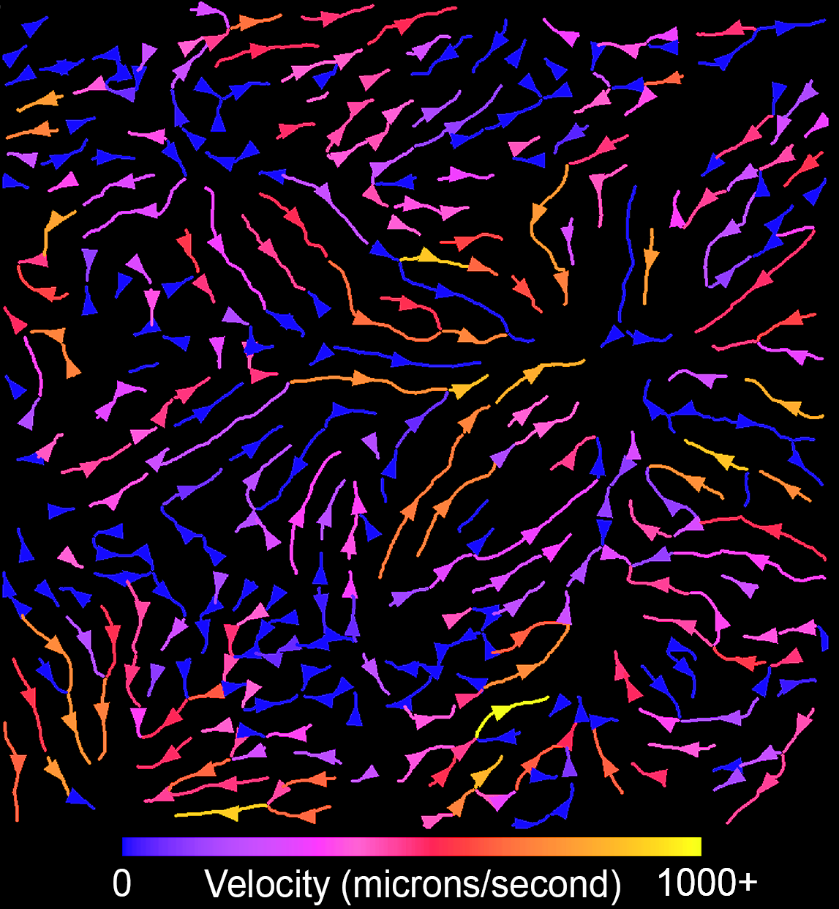
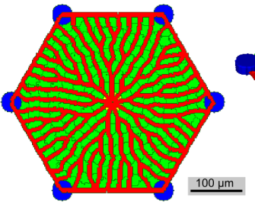
Development of a Multiscale Mechanistic Simulation of Acetaminophen Induced Liver Damage
The model: The liver is a frequent site of toxicity caused by drugs and environmental pollutants. We have previously developed a multiscale model of xenobiotic metabolism that allows us to couple coarse clinical measurements, such as blood levels of a toxicant or markers of liver damage, to a detailed liver model including the microvasculature and metabolic pathways. To calibrate this model we have collected detailed serum profiles, tissue histology and intravital microscopy data of the blood flow within the liver of a live animal.
What is new inside? Our intravital studies provided the first direct measurement of blood flow though the liver of a living animal after treatment with a typical liver toxin (Acetaminophen, APAP). In addition, we have longitudinal data across the key time window of APAP induced liver toxicity.
How will this change current practice? Our data and models provide insights into the relationship between clinical markers of liver damage (e.g., serum markers) and the changes in blood flow and cell damage. Changes in liver blood flow have long been recognized as key responses but the details at the microvasculature scale have been unknown.
End Users can couple these new flow models to previous models (such as our multiscale standards based liver model) to explain and predict the patterns of liver damage caused by liver toxicants.
B
Intravital microscopy of liver injury. Multiphoton fluorescence images of the liver in a living mouse after IP injection of 250 mg/kg APAP. Individual red blood cells are visible and the blue areas are focal lesions. This is a still from a video.
Automated measures of microvascular flow in the liver of a living mouse. Nearly instantaneous measurements of micro-vascular flow can be obtained from cross-correlation analysis of video micrographs collected at 100 frames per second.
Calculated flow velocities (right) within a virtual sinusoid network (left). Color bar is velocities in um/s.
James Glazier, James Klaunig, Ken Dunn;
Indiana University, Grant: GM111243
Notes:
This project completed 6/2018. A small no cost extension runs through 6/2019, which is being used to complete animal studies.
For future work we are investigating the use of AI to generate maps of diffusible fields to either accelerate, or completely replace, PDE based diffusion solvers.
PI name, email: James A Glazier: jaglazier@gmail.com or James Sluka: jsluka@Indiana.edu

Slide 17
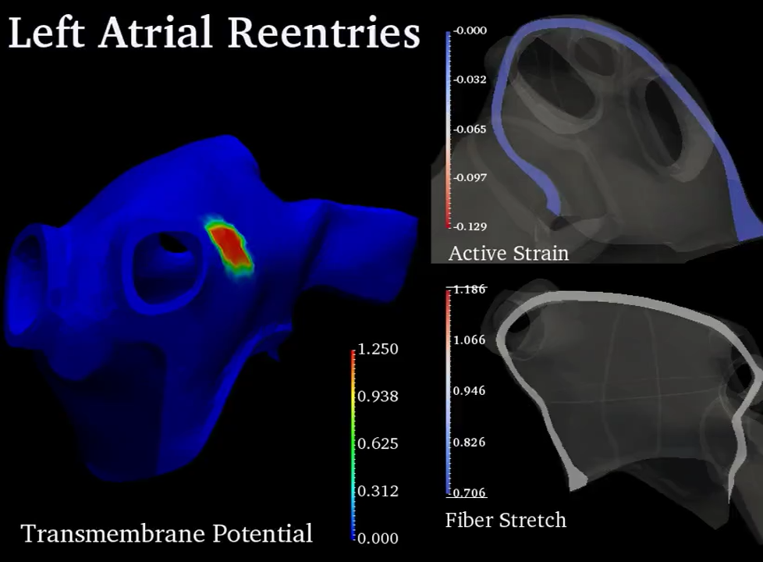
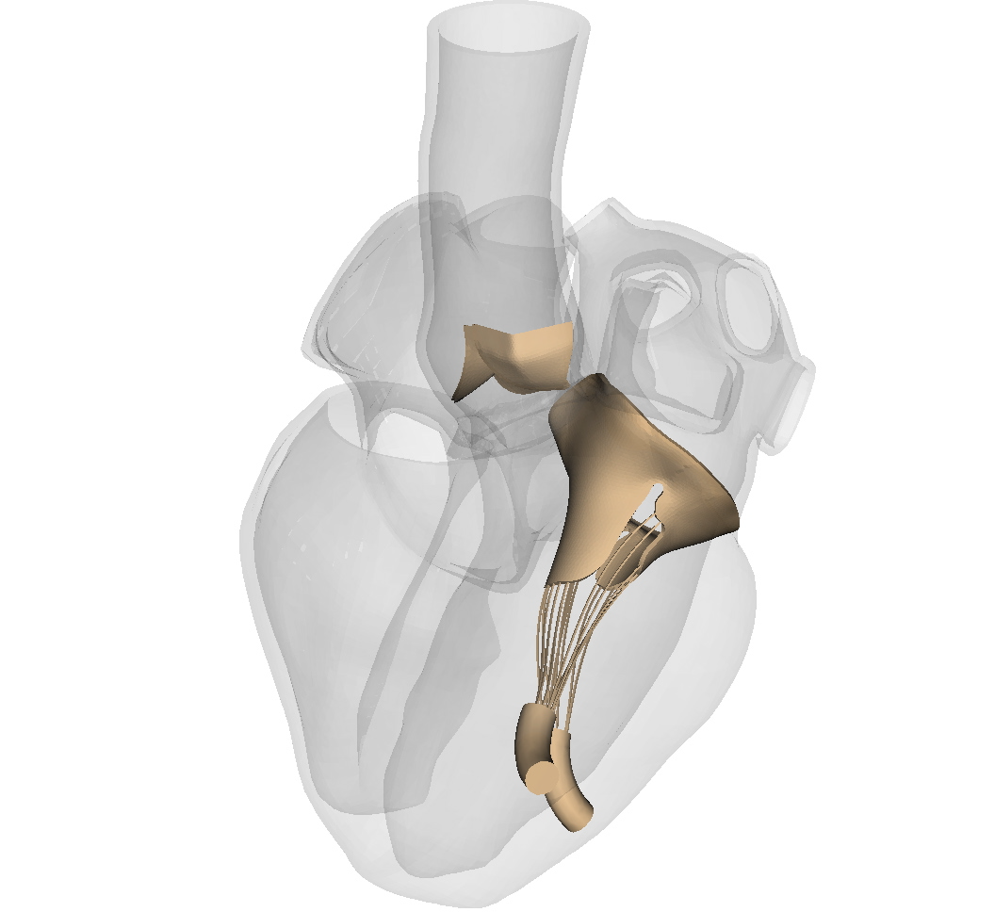
Multiscale modeling of clotting risk in atrial fibrillation
The model: We are developing multiscale models of the heart that describe clotting
in patients with atrial fibrillation (AF), which is the most common sustained
arrhythmia in the US and associated with elevated clotting risk. These models will
integrate electro-mechanical coupling, fluid-structure interaction (FSI), and
thrombogenesis, and will be parameterized and validated using clinical data.
What is new inside? Prior models of blood flow in AF have focused on computational
fluid dynamics (CFD) approaches, which prescribe the motion of the heart wall, or
treat it as a stationary boundary. We are developing the first FSI models of AF. Adding
electro-mechanical coupling will enable predictions of the impact on flows of
electrophysiological interventions such as catheter ablation therapy for AF.
How will this change current practice? Current clinical indices for assessing clotting
risk in AF classify most patients as being at intermediate risk, possibly resulting in
overuse of anticoagulants in AF patients. We aim to provide a mechanistic
description of clotting in AF that can inform improved metrics and indices.
End Users: We are developing a comprehensive modeling platform that will be
applicable to a range of use cases in cardiac modeling and simulation.
Boyce Griffith – UNC
Craig Henriquez – Duke
Aaron Fogelson – Utah
NIH U01HL143336
Notes:
Summary: This project aims to develop multiscale computational models for predicting clotting in patients with atrial fibrillation (AF). AF is the most common heart rhythm disorder in the United States, and AF patients have an increased risk of developing blood clots that can cause serious medical complications, including strokes. Tools for modeling blood flow and clotting in AF and treatments for AF promise to improve clinical risk assessment for these patients.
Machine Learning: Machine learning could see several uses within this project: 1) computer vision approaches to extracting anatomical data from patient image data and associated geometrical model construction; 2) model acceleration (e.g. as a replacement for solving systems of partial differential equations in each time step); 3) automated model reduction for constructing representations amenable to optimization, enabling design.
Future Challenges: A key challenge is that the current mechanistic models require lengthy computations. We believe that such models are important for providing insight and understanding, but simplified versions may be necessary to realize translational impact.
Multiscale Modeling: There are two key modeling challenges that we are seeking to address in this project. 1) We aim to develop computationally tractable models of flow within the highly trabeculated left atrial appendage. This is analogous to flow within a poroelastic medium. We seek to understand whether and when homogenized models that do not account for the details of the trabeculation are sufficient. 2) We aim to develop algorithms for linking biological processes with vastly different timescales, to wit, the timescale of the heartbeat (1 second) and the timescale of clotting (minutes, hours, days). Direct numerical simulation is not feasible, and models or numerical methods for sampling the fast and slow variables are needed.
PI name, email: Boyce Griffith – University of North Carolina at Chapel Hill – boyceg@email.unc.edu; Subaward PIs: Craig Henriquez – Duke University - ch@duke.edu and Aaron Fogelson – University of Utah – fogelson@math.utah.edu

Slide 18
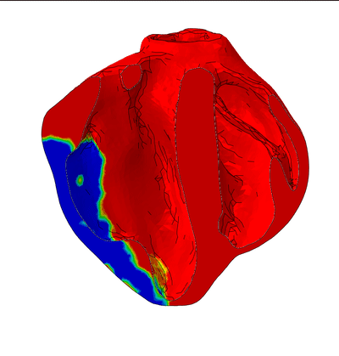
Validated Multi-Scale Model of Ischemic Heart Failure
The model {purpose of model and video of simulation}
To realistically simulate regional mechanics (myocardial stress and strain) during progression of ischemic heart failure (IHF) and chronic response to novel treatments for IHF.
What is new inside? {describe new math, new algorithm}
Model includes unprecedented geometric detail (papillary muscles, trabeculae) based on high-resolution ex-vivo diffusion tensor MRI of porcine biventricular unit following percutaneous creation of multiple myocardial infarctions. It is validated against real-time 3D transesophageal echocardiography (speckle-tracking measurements of circumferential and longitudinal strain in 16 AHA regions/segments).
How will this change current practice? {Why is this important?}
Heart failure (HF) is a worldwide epidemic. The majority of HF cases are due to myocardial infarction. Our validated model of IHF can be used to test the efficacy of existing treatments and design new ones to be tested using our percutaneous clinically-relevant animal model.
End Users {Stakeholders? Needed expertise? Data & platform needed?}
Cardiologists and cardiac surgeons can team up with a mechanical engineer to run the
model using the finite element method and our data on ventricular geometry,
mechanical properties and boundary conditions.
JM Guccione & GS Kassab
UCSF, Cal Med innov. Inst.
Grant support: Agency, #}
NIBIB U01HL119578
Notes:
define/explain it enough for a non-scientific person to explain to the general public (2-3 sentences)
We have developed and validated multi-scale models of multiple failing hearts using the same advanced simulation technology that the automotive, aerospace, energy and hi-tech industries rely on to test their product before they are built. Our model allows for medical devices to be designed and safely tested in the virtual world before ever being tested in the real world. Our model is based on experimental multi-scale measurements with unprecedented detail in a clinically-relevant large animal model of heart failure.
mention how can machine learning and AI help your project (2 sentences)
We have used our physics-based 3D model input and output data to train a machine learning algorithm that can accurately reproduce time courses of heart chamber pressures and volumes, as well as regional distributions of heart muscle fiber force development (stress) and deformation (strain). The machine learning algorithm is 6 orders of magnitude faster than our physics-based 3D model.
List future challenges or next steps after your project is done (1 sentence)
Next steps are to make experimental multi-scale measurements with unprecedented detail in a clinically-relevant large animal model of heart failure after treatment with novel medical devices (e.g., minimally invasive ventricular polymeric injection).
Further details for Notes section - For the following communities (2 sentences):
Multiscale modeling: explain how the math will address methodological challenges (e.g.: crossing scales, sparse data, uncertainty, modularity, spatiotemporal simulation challenges, etc.)
The finite element method is a rigorous (and widely accepted) mathematical method for numerically solving the partial differential equations that govern the mechanics of deformable bodies (conservation of mass and momentum). To reconcile our finite element model with multi-scale experimental measurements such as heart chamber geometry versus heart cell dimensions (diameter, sarcomere length, sarcomere number) we use machine learning (Bayesian inference).
PI name, email: Julius Guccione (Contact PI), Julius.Guccione@ucsf.edu; Ghassan Kassab (MPI), gkassab@calmi2.org

Slide 19
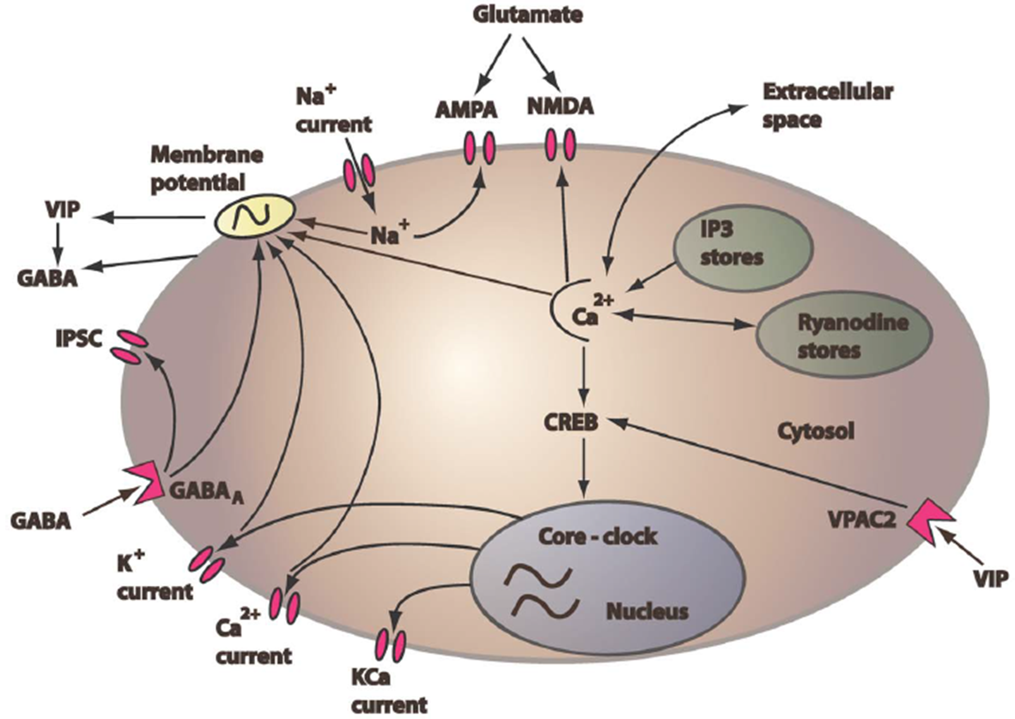
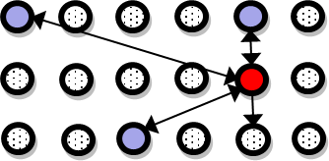
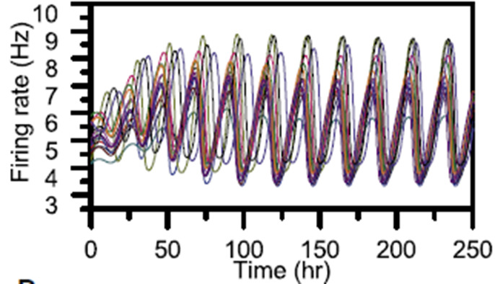
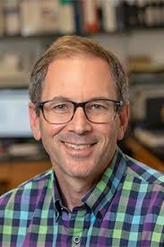

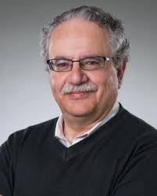
Multiscale Neural Model of the Human Circadian Clock
The model: We are developing a multiscale model of the human circadian clock and novel computational tools to gain improved understanding of neural network connectivity, synchronization and entrainment properties observed in targeted experiments.
+
+
=
Single neuron model
Intracellular model
Network model
Network dynamics
What is new inside? We are developing data-driven techniques for effective order reduction of neural network models and acceleration of network simulation and parametric studies. Multiscale computational techniques being developed include manifold/machine learning tools such as diffusion maps and equation-free simulation techniques.
How will this change current practice? Improved understanding of neural communication in the human clock could help treat circadian disruptions associated with sleep loss, erratic wake times, obesity, diabetes and schizophrenia. Neural network order reduction and accelerated simulation methods could have broad applicability to brain systems.
End Users: Our circadian model and network simulation tools will be valuable to circadian biologists, network scientists and systems biologists interested in exploring clock mechanisms, function/dysfunction and emergent dynamics. All computational models and simulation/analysis tools are being developed in MATLAB and Python.
Michael Henson, U. Massachusetts
Erik Herzog, Washington U.
Yannis Kevrekidis, Johns Hopkins U.
NIBIB U01-EB021956
Notes:
The mammalian circadian clock located in the hypothalamus of the brain consists of approximately 20,000 pacemaker neurons that are coupled together to produce a robust overall rhythm that drives bodily functions such as sleep patterns. The clock represents an ideal model system for studying biological network design and behavior due to accumulating data on individual neurons and their interactions. The goal of this project is to develop a multiscale model of the circadian clock and to integrate this model with targeted experiments and novel computational tools to gain improved understanding of network connectivity, synchronization and entrainment properties.
To perform order reduction and accelerate simulation of the neural network model, we are developing a suite of machine learning tools specialized for heterogeneous neural networks. These techniques include diffusion maps, manifold learning techniques with input-output informed kernels and equation-free simulation techniques. Upon completion of this U01 project, we will be well positioned to combine the the neural network model and accelerated simulation tools to computationally identify promising therapeutic strategies for counteracting circadian dysfunction.
Our multiscale tools will provide effective spatiotemporal simulation of heterogeneous oscillators on heterogeneous networks over time scales ranging from hours to entire seasons. The multiscale modeling framework will allow direct incorporation of sparse data on individual oscillators (e.g. heterogeneous periods and amplitudes) as well as network properties (e.g. average connectivity, degree distribution).
Dr. Michael A. Henson, mhenson@umass.edu

Slide 20
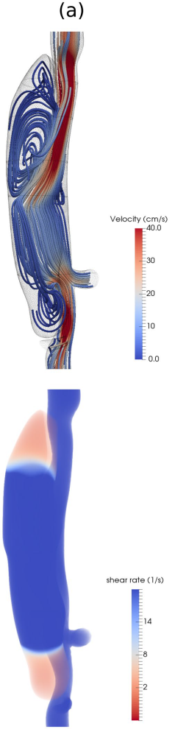

Multiscale Multiphysics Model of Thrombus Biomechanics
in Aortic Dissection
1
The model. The overall goal of this project is to create a new class of computa-tional models to describe and predict thrombus formation and remodeling within the false lumen of aortic dissections. Toward this end, we have developed new multimodality in vivo / in vitro imaging methods to inform (1) continuum modeling of the hemodynamics, which in turn (2) drives new particle-based modeling of the thrombus formation, which we have shown to allow the first description as well as prediction of the formation of intramural thrombus in a common mouse model of aortic dissection (as seen in the images to the right).
What is new inside? The primary novelties in mathematical modeling have been the development of new continuum/particle-based models of both the blood flow (with embedded platelet-like particles) and the arterial wall (with embedded particle-like local accumulations of matrix). For the former, we use a “force coupling method” and for the latter we use a novel extension of “smoothed particle hydro-dynamics” for nonlinear elasticity.
How will this change current practice? Continuum/particle-based models provide a unique method to increase biological resolution while preserving computational advantages of continuum solutions on large spatial domains.
End Users. Primarily bioengineers interested in understanding thrombus bio-mechanics, ultimately with the goal of understanding better to treat dissections.
2
J.D Humphrey (Yale)
G.E. Karniadakis (Brown)
Grant: U01 HL116323
Notes:
Instructions:
Submit 1 slide by COB Monday 2/25/19
Title - headline your theory-driven, mechanistic model
name the specific mathematical or statistical method and variations thereof
To include in NOTES section
define/explain it enough for a non-scientific person to explain to the general public (2-3 sentences)
mention how can machine learning and AI help your project (2 sentences)
List future challenges or next steps after your project is done (1 sentence)
Further details for Notes section - For the following communities (2 sentences):
Behavioral modeling: explain the new theories that will integrate within person dynamics with between person dynamics
Multiscale modeling: explain how the math will address methodological challenges (e.g.: crossing scales, sparse data, uncertainty, modularity, spatiotemporal simulation challenges, etc.)
Medical simulation: explain the math challenges being overcome (e.g. collision dynamics, cloth dynamics, haptics, etc.)
Analysis: explain how new statistical approaches will provide mechanistic understanding of the system
BRAIN: explain the theory behind the math/stats and how it will be used to understand how the brain works; explain the level of data dependency on your model (e.g.: (a) completely abstract toy model, (b) a coarse-grained model based on a high level view of previous data, (c) a model based directly on one kind of data (e.g., neural recordings) or (d) a model synthesizing multiple data types (e.g., neural recordings and connectomics).
PI name, email:

Slide 21



Multiscale Modeling of Sickle Cell Anemia: Methods and Validation
The model: The pathophysiology of sickle cell disease is organ-specific and it involves several processes across multiple time scale from O(10⁻¹ s) to O(10³ s) and length scales from O(10⁻⁹ m) for the size of the protein to O(10⁻²m) for the size of the organ. Therefore, we developed multiscale models to quantify the connections between the pathogenesis and clinical manifestations.
What is new inside?
Synergistic integration of in silico, in vitro, in vivo and ex vivo data: we integrate in silico data from multiscale simulations, in vitro data from microfluidic experiments, in vivo data from sickle cell disease patients and ex vivo data from perfusion of human spleen via multifidelity methods. Our group has recently developed deep and active learning multifidelity formulations for fusing different information sources (e.g., simulation, experimental and clinical data) in order to derive “unknown” functional relationships for quantities of interest that direct therapeutic interventions as a function of many independent parameters.
How will this change current practice?
Multiscale modeling is essential in exploring human spleen filtration of sickle red blood cell because these multidimensional processes cannot be directly observed in humans. Existing mouse models are not sufficient to
describe the human splenic filtration function due to the different spleen filtering structures.
The proposed framework can help physicians determine how fast the function of the spleen
declines and thus guide patients and physicians exposed to complex situations required to make
decisions (splenectomy or not).
End Users {biomedical engineers, biophysicists, physicians}
George Em Karniadakis
Brown University
Grant: NIH, U01HL114476
Notes:
Instructions:
Submit 1 slide by COB Monday 2/25/19
Title - headline your theory-driven, mechanistic model
name the specific mathematical or statistical method and variations thereof
To include in NOTES section
define/explain it enough for a non-scientific person to explain to the general public (2-3 sentences)
mention how can machine learning and AI help your project (2 sentences)
List future challenges or next steps after your project is done (1 sentence)
Further details for Notes section - For the following communities (2 sentences):
Multiscale modeling: explain how the math will address methodological challenges (e.g.: crossing scales, sparse data, uncertainty, modularity, spatiotemporal simulation challenges, etc.)
PI name: George Karniadakis email: george_karniadakis@brown.edu

Slide 22


Combining wet lab and computational simulations to predict optimal antibiotic drug regimens for Mycobacterium tuberculosis
Denise Kirschner, Jennifer Linderman (UM), JoAnne Flynn (UPitt)., Veronique Dartois (Rutgers)
Problem: Tuberculosis is the number one cause of death due to infectious disease. Drug treatment is long
(9 months), with multiple drugs and resistance is prevalent. No rational approach to drug regimen design exists.
How we approach it:
We designed an integrated computational/experimental approach to optimizing drug regimen
We developed an MSM of granuloma formation, antibiotic distribution, antibiotic treatment
We predict optimal solutions for treatment that we will test in the non-human primate
Details:
We utilize a cellular and tissue scale agent-based model to simulate immune cell and bacterial interactions on a two- or three-dimensional spatial grid to capture the emergent behavior of granuloma formation
At the molecular scale, blood vessels in the agent-based model deliver antibiotics into lung tissue where antibiotics undergo diffusion, extracellular binding, and cellular partitioning
Collaborative third-party evaluation of MSM projects can lead to technical and scientific benefits for funded U01 projects
We apply a surrogate-assisted optimization framework to predict optimal sterilizing regimens,
providing an efficient way to identify optimal regimens
We use sensitivity/uncertainty analysis to define parameters & predict factors driving outcomes
We created a team with other MSM members for model credibility practices (see cartoon).
Blemker, Linderman, Kirschner, Peirce-Cottler

Slide 23
Multi-scale modeling of influenza vaccination for optimal T cell immunity
Problems with the current influenza vaccine:
low and variable vaccine efficacy requires frequent reformulation does not protect against pandemic strains
End Users: The multi-scale models will guide the development of new T cell-based
vaccine and strategies for its implementation.
Background and Approach: Most current universal influenza vaccine research targets conserved antibody epitopes. However, T cells epitopes are also conserved and are potential targets for vaccination. The effectiveness of T cell-based vaccine is complicated by two main factors. First, pre-existing immunity preventing the attenuated vaccine virus from replicating and inducing an immune response. Second, T cell immunity prevents pathology (and to a lesser extent infection), so vaccine effectiveness needs to take into account boosting of immunity by asymptomatic infection with the circulating virus.
What is new inside?
Development and empirical validation of a quantitative framework to determine how CD8 T cell immunity affects dynamics of infection and transmission.
Multi-scale model that incorporates reciprocal feedback between immunity at the individual level and boosting at the epidemiological level.
PIs: Jacob Kohlmeier & Veronika Zarnitsyna
(Emory University)
Grant support: NIH/NHLBI U01 HL139483-01A1
Notes:
Successful vaccination involves two scales. At the within-host scale, the design and construction of an effective vaccine requires a quantitative understanding of the interaction of the virus (or protein antigen) and the immune response, specifically, (i) the magnitude of immunological memory generated, (ii) how that memory wanes, and (iii) the degree to which memory provides protection following infection. At the between-host or epidemiological level, mathematical models can provide a quantitative understanding of how to best use the vaccine and maximize the effects of herd immunity.
The current inactivated influenza A virus vaccine requires an antigenic match between the vaccine and circulating strains. Antibodies induced by vaccination or exposure to earlier virus strains drive the selection of antibody-escaping mutants and result in the rapid virus evolution (antigenic drift).
An existing type of vaccine, known as a live attenuated influenza vaccine (LAIV) elicits memory CD8 T cell responses to conserved epitopes. The effectiveness of T cell-based vaccine is complicated by two main factors: (1) It can be impacted by pre-existing immunity preventing the attenuated virus from replicating and inducing an immune response; (2) The effectiveness of the vaccine may be substantially boosted if immunized individuals experience asymptomatic infection by circulating influenza virus.
Universal influenza vaccines against the conserved CD8 T cell epitopes of influenza A virus will minimize the burden of seasonal outbreaks and prepare for the pandemics. Determining the effectiveness of T cell-based immunizations, such as with live attenuated influenza vaccines (LAIV), require taking into account the pre-existing immunity from prior vaccinations or natural infections, and this can only be done by novel multi-scale models integrating within-host and epidemiological scales.

Slide 24
Modular Design of Multi-Scale Models, With an Appl. to the Innate Imm. Response to Fungal Resp. Pathogens
PIs: R. Laubenbacher (contact), UConn SOM and Jackson Lab. for Genomic Medicine, B. Mehrad, U Florida SOM, W. Schroeder, Kitware Inc.
Funding: 1U01EB024501-01
The model integrates events at the intracellular, lung tissue, whole-lung, and organismal levels to help study host-centric interventions in invasive aspergillosis. An important focus is on the development of novel modular design principles for such complex models that more easily enable reproducibility, extendibility, and integration with other models.
What is new inside? The model integrates discrete dynamic intracellular network models (in the form of generalized Boolean networks), an agent-based tissue model, an equation-based model for processes in the liver, combined with PDE models for diffusion of various molecules. The modular architecture of the combined multi-scale model provides novel ways of integrating mathematical models at the different scales.
One novel aspect of the project is a sophisticated interactive simulation interface that allows the end user to interact directly with the model as a virtual laboratory, without needing a modeler as an intermediary. This is achieved through a unique collaboration between a modeling group, a laboratory led by a clinician/scientist (a representative end user), and a company specializing in scientific visualization and computation.
How will this change current practice? The model we are building in this project will form the platform for model-based design of host-centric interventions, expanding current approaches to treating invasive aspergillosis.
End Users Clinician scientists, immunologists, computational biologists. Model access will be through a web-based platform. No specific modeling skills are needed for its use.
Notes:
This project aims to develop a mathematical model that can serve as a virtual laboratory to investigate novel interventions in invasive aspergillosis, a serious disease affecting immunocompromised patients, with a mortality rate of almost 50%, with standard-of-care treatment. The project will also develop novel software engineering techniques to allow the extension of such models to include a large number of disease-relevant features, making the model increasingly realistic and versatile.
Future challenges include the identification of important immunological and pathogenic variables that allow the personalization of the model to capture the immunological profile of an individual patient and, possibly, the genetic make-up of the particular fungal strain that caused the infection.
Multiscale modeling: The project will address two challenges related to multi-scale modeling. First, the proliferation of component models at the different scales represents a significant challenge when the model needs to be modified or extended subsequently. Second, there is a wide range of heterogeneous data generated, from experimental data and metadata to data from simulation runs with many varying sets of parameters. This project is building an information management platform to solve this problem.
PI: Reinhard Laubenbacher, laubenbacher@uchc.edu

Slide 25

Multiscale spatiotemporal modeling of cardiac mitochondria
The model - We are modeling how the nanostructure of mitochondria affects the internal distribution of metabolites and signaling molecules, thereby affecting production of useable energy for the cell in the form of ATP. This is important because mitochondrial structure is known to change during different physiological and disease states. Understanding how these changes alter energy metabolism is important to understanding disease processes.
What is new inside? - The creation of an accurate spatial model for mitochondrial metabolism at the nanoscale has not previously been done. We have compiled a database of mitochondrial structures by electron microscopic tomography of cardiac muscle. To construct mitochondrial compartments in silico, we have had to create a new algorithm to automatically identify and render the intricate 3D membrane surfaces within the mitochondria.
How will this change current practice? - We find that outcomes of computer simulations of energy metabolism are significantly affected by known variations in mitochondrial membrane topology. Thus, in many cases, current
practice of running simulations in generalized compartments will have to change to include structure explicitly. Likewise. as the efficiency and reliability of automated membrane segmentation increases, it will replace the current labor and time intensive process of manual tracing of membranes inside tomograms..
End Users - Metabolic modeling will useable by a wide range of biomedical researchers on platforms like Virtual Cell. Automated segmentation will be generally useful for electron microscopy and might be applicable to other grainy images such at CT scans which can have medical and industrial applications.
Raquel A. Adams¹, Carmen A. Mannella^{2,3,} W. Jonathan Lederer³. M. Saleet Jafri^{1,3}
¹George Mason University ²New York State Department of Health ³University of Maryland School of Medicine
NHLBI U01HL116321
Notes:
Instructions:
Submit 1 slide by COB Monday 2/25/19
Title - headline your theory-driven, mechanistic model
name the specific mathematical or statistical method and variations thereof
To include in NOTES section
define/explain it enough for a non-scientific person to explain to the general public (2-3 sentences)
mention how can machine learning and AI help your project (2 sentences)
List future challenges or next steps after your project is done (1 sentence)
Further details for Notes section - For the following communities (2 sentences):
Behavioral modeling: explain the new theories that will integrate within person dynamics with between person dynamics
Multiscale modeling: explain how the math will address methodological challenges (e.g.: crossing scales, sparse data, uncertainty, modularity, spatiotemporal simulation challenges, etc.)
Medical simulation: explain the math challenges being overcome (e.g. collision dynamics, cloth dynamics, haptics, etc.)
Analysis: explain how new statistical approaches will provide mechanistic understanding of the system
BRAIN: explain the theory behind the math/stats and how it will be used to understand how the brain works; explain the level of data dependency on your model (e.g.: (a) completely abstract toy model, (b) a coarse-grained model based on a high level view of previous data, (c) a model based directly on one kind of data (e.g., neural recordings) or (d) a model synthesizing multiple data types (e.g., neural recordings and connectomics).
PI name, email:

Slide 26



An integrative statistics-guided image-based multi-scale lung model
The model a multi-scale computed tomography (CT) imaging-based lung model based on machine/deep learning to bridge individual and sub-group (cluster) scales in asthma and COPD populations, and explore the notion of cluster-guided computational fluid dynamics (CFD) analysis that generates model-derived flow and particle variables to better understand structure-function relationships in the human lungs by diseased sub-groups.
What is new inside? We overcame the three challenges, including inter-subject variability (due to, for example, gender, age and height), inter-site variability (due to scanner and imaging protocol differences), and definition of novel quantitative CT (QCT) imaging-based metrics at multiple scales (due to alterations at different disease stages) needed for machine/deep learning and use of the cluster membership to guide subject-specific CFD analysis enables an examination of the cluster-specific structural and functional relationships toward precision medicine.
How will this change current practice? The new sub-groups (clusters) for asthma and COPD patients and their disease progressions may provide better treatment targets in the future.
End Users. The CT imaging-based variables could be used by other research groups to develop more sophisticated deep learning neural network (NN) models. The model has the potential to identify clinically-meaningful sub-groups to better understand disease progressions and subsequently develop cluster-specific treatments.
Ching-Long Lin, UIowa
Eric A Hoffman, UIowa
Grant: NHLBI, U01HL114494
Notes:
Instructions:
Submit 1 slide by COB Monday 2/25/19
Title - headline your theory-driven, mechanistic model
name the specific mathematical or statistical method and variations thereof
To include in NOTES section
define/explain it enough for a non-scientific person to explain to the general public (2-3 sentences)
mention how can machine learning and AI help your project (2 sentences)
List future challenges or next steps after your project is done (1 sentence)
Further details for Notes section - For the following communities (2 sentences):
Behavioral modeling: explain the new theories that will integrate within person dynamics with between person dynamics
Multiscale modeling: explain how the math will address methodological challenges (e.g.: crossing scales, sparse data, uncertainty, modularity, spatiotemporal simulation challenges, etc.)
Medical simulation: explain the math challenges being overcome (e.g. collision dynamics, cloth dynamics, haptics, etc.)
Analysis: explain how new statistical approaches will provide mechanistic understanding of the system
BRAIN: explain the theory behind the math/stats and how it will be used to understand how the brain works; explain the level of data dependency on your model (e.g.: (a) completely abstract toy model, (b) a coarse-grained model based on a high level view of previous data, (c) a model based directly on one kind of data (e.g., neural recordings) or (d) a model synthesizing multiple data types (e.g., neural recordings and connectomics).
PI name, email:

Slide 27

Detailed model of primary motor cortex
William Lytton, SUNY Downstate U01EB017695
Coupled ODE and event driven simulation defined in a novel high-level declarative language using NetPyNE
Gradient descent and genetic algorithms were used to determine parameters for particular cell types. Project won the 2017 HPCwire Readers' Choice Award for Best Use of Artificial Intelligence using HPC .
End Users: Growing interest in multiscale modeling: Human Brain Project, Blue Brain Project, Allen Brain Institute, many individual research labs contributing to ModelDB.

Slide 28



Multiscale Models of Wound Cell
Plasticity for Regeneration – Year One
A first-ever multiscale model of epidermal-dermal interactions during skin wound healing
Experimental Dermatology, 2019
PROJECT GOAL
Identify the critical molecular conditions and multiscale interactions to shift wound repair
toward regeneration and away from scarring
Math tools used in the three papers:
Single-cell analysis reveals fibroblast heterogeneity and myeloid-derived adipocyte progenitors in skin wounds
Nature Communications, 2019
Stochastic ODEs, nonlinear PDEs, optimization, graph theory, statistical physics, dimensional reduction methods, and stochastic processes
Using a panel of single-cell tools as a type of “computational microscope” that examines thousands of individual cells at once, we discovered an unexpectedly high degree of fibroblast diversity. This result suggests possible treatments for scar-free wound healing that target the body’s own blood cells.
An Ovol2-Zeb1 transcriptional circuit regulates
epithelial directional migration and proliferation
EMBO Reports, 2018
Efficient wound repair involves coordinated movements and cellular proliferation of skin epithelial cells. We discovered the EMT repressor Ovol2 has a major role in promoting directional migration and proliferation of adult epithelial cells.
Xing Dai, Qing Nie (contact), Max Plikus, University of California, Irvine
NIAMS U01AR073159 – co-funding NIBIB (9/2018-8/2023)
Notes:
Instructions:
Submit 1 slide by COB Monday 2/25/19
Title - headline your theory-driven, mechanistic model
Multiscale Models of Wound Cell Plasticity for Regeneration
name the specific mathematical or statistical method and variations thereof
Our data-driven multiscale modeling tackles several current critical gaps and major computational and multiscale challenges,
including: (1) characterizing functional cell populations and critical transitions between cellular states from high-dimensional
gene expression space; (2) multiscale interplay among events that occur at tissue (HF
regeneration), cell (cell division), and molecular (gene transcription) timescales; (3) feedback and
communication among different pathways or types of cells; (4) coupled agent-based and continuum model
components; and (5) emerging stochastic dynamics arising from intrinsic and extrinsic variability.
To include in NOTES section
define/explain it enough for a non-scientific person to explain to the general public (2-3 sentences)
An ideal outcome of wound healing is to close the wound through a regeneration process without creating
any scars. Our preliminary data on large wound on mouse skin suggests new hairs and new fate are important elements for such perfect
wound healing. The goal of the project is to identify the critical conditions to shift wound repair toward regeneration
and away from scarring.
mention how can machine learning and AI help your project (2 sentences)
For this project, we are using machine (deep) learning to analyze single-cell RNA-seq data and ATAC-seq data to link
genomic information with the multiple cellular states and their transitions and lineage relationships. We are also
using machine (deep) learning techniques to connect the spatial imaging data that contains information of small number of genes with
non-spatial single-cell genomics data along with spatial multiscale models. In general, deep learning methods serve as a bridge between multiple
Heterogeneous datasets and multiscale modeling.
List future challenges or next steps after your project is done (1 sentence)
Further details for Notes section - For the following communities (2 sentences):
Behavioral modeling: explain the new theories that will integrate within person dynamics with between person dynamics
Multiscale modeling: explain how the math will address methodological challenges (e.g.: crossing scales, sparse data, uncertainty, modularity, spatiotemporal simulation challenges, etc.)
Developing single-cell based multiscale models that integrate genomics information, however, in the context of spatial dynamics and being constrained by cell-cell interactions (in terms of both biochemical signals and physical cues.
Medical simulation: explain the math challenges being overcome (e.g. collision dynamics, cloth dynamics, haptics, etc.)
Analysis: explain how new statistical approaches will provide mechanistic understanding of the system
BRAIN: explain the theory behind the math/stats and how it will be used to understand how the brain works; explain the level of data dependency on your model (e.g.: (a) completely abstract toy model, (b) a coarse-grained model based on a high level view of previous data, (c) a model based directly on one kind of data (e.g., neural recordings) or (d) a model synthesizing multiple data types (e.g., neural recordings and connectomics).
PI name, email: Qing Nie (qnie@uci.edu)

Slide 29


Multiscale modeling to map cardiac electrophysiology between species
The model (1) Improved ODE representations of cardiomyocyte electrophysiology and intracellular calcium
(2) Statistical models of heterogeneous cell populations
What is new inside?
New methods for tuning parameters and building models specific to individual samples
Combined mechanistic ODE models with statistical, machine learning approaches
Impact: Improved methods for validating and tuning models, leading to more credible representations
End users: Cardiologists, cardiac physiologists, safety pharmacologists interested in preventing adverse cardiac events
Eric Sobie, Mount Sinai
David Christini, Weill Cornell
U01 HL 136297
Notes:
Project overview: Cardiac arrhythmias kill hundreds of thousands of people each year, but the heart's inherent complexity prevents experiments from illuminating all aspects of arrhythmias. While computational modeling fills many of the experimental voids, important limitations restrict the utility of these models. The overall goal of this project is to develop novel approaches for multiscale cardiac electrophysiology modeling, including protocols for more predictive models, rigorous representations of variability between samples, quantitative mappings between species, and the effects of heterogeneity at the tissue level.
Machine learning and AI were part of the original research plan and are actively used in this project. Genetic algorithms are used to automatically tune model parameters. Multivariable regression is used to map drug responses across cell types. More recently, algorithms such as random forests and convolutional neural networks are being used to identify sub-populations with increased arrhythmia risk.
Future challenges are the conclusion of this project will be to use models of this type in regulatory decision making, such as during drug development, and to apply the methodologies to additional, clinically-relevant problems.
How will the results be used within particular communities:
Behavioral modeling – Methods to infer molecular level differences between individuals based on phenotypic differences
Multiscale modeling – Application of machine learning will both improve the ODE models provide insight into variability
Medical simulation – Improved understanding of mechanism underlying cardiac arrhythmias
Analysis – Machine learning approaches illustrate gaps in the ODE representations and suggest experiments for improving ML performance
BRAIN – Not Applicable
Submit 1 slide by COB Monday 2/25/19
Title - headline your theory-driven, mechanistic model
name the specific mathematical or statistical method and variations thereof
To include in NOTES section
define/explain it enough for a non-scientific person to explain to the general public (2-3 sentences)
mention how can machine learning and AI help your project (2 sentences)
List future challenges or next steps after your project is done (1 sentence)
Further details for Notes section - For the following communities (2 sentences):
Behavioral modeling: explain the new theories that will integrate within person dynamics with between person dynamics
Multiscale modeling: explain how the math will address methodological challenges (e.g.: crossing scales, sparse data, uncertainty, modularity, spatiotemporal simulation challenges, etc.)
Medical simulation: explain the math challenges being overcome (e.g. collision dynamics, cloth dynamics, haptics, etc.)
Analysis: explain how new statistical approaches will provide mechanistic understanding of the system
BRAIN: explain the theory behind the math/stats and how it will be used to understand how the brain works; explain the level of data dependency on your model (e.g.: (a) completely abstract toy model, (b) a coarse-grained model based on a high level view of previous data, (c) a model based directly on one kind of data (e.g., neural recordings) or (d) a model synthesizing multiple data types (e.g., neural recordings and connectomics).
PI name, email:

Slide 30
Modeling Multiscale Control of Liver Regeneration
The model
The objective is to incorporate single cell data sets into
a multiscale network model of complex tissue response
dynamics. The model accounts for dynamic transitions
between functional states of multiple liver cell types,
coupled with production, clearance, and signaling of
multiple molecular species.
What is new inside?
Emerging single cell data sets yield unprecedented view
of how cells in a tissue are distributed over a set of
functional states. Our approach takes the snapshot data from single cell omics and infers the dynamics of cell state transitions using a model-based approach.
How will this change current practice?
Potential to usher in a new era of convergence between single cell omics, bioinformatics, and dynamic modeling.
End Users
The next-generation of systems biologists and computational clinicians can use the new methods to bridge the presently divergent fields of bioinformatics and systems engineering.
Raj Vadigepalli and Jan Hoek
Thomas Jefferson University
Grant support: NIBIB, U01 EB023224
Notes:
Technological advances in molecular measurements are enabling an unprecedented view of how individual cells in a complex tissue respond and change in physiological and pathological scenarios. There is an unmet need to translate the insights from these large volumes of data into a mechanistic understanding of disease processes. The potential is to build a whole new class of clinical decision-making tools enabled by biological big data analysis and model-based systems engineering.
mention how can machine learning and AI help your project (2 sentences)
Machine learning and AI can help the project by enabling analysis of large volumes of single cell data sets we and others are collecting in order to derive detailed maps of cell functional states and their dynamic transitions during tissue injury and disease.
List future challenges or next steps after your project is done (1 sentence)
A key future challenge is to scale the approach to multiple tissue contexts so as to build organism-scale reference maps of cell states and state transitions, towards a multiscale molecular and cellular Virtual Physiological Human.
Multiscale modeling: explain how the math will address methodological challenges (e.g.: crossing scales, sparse data, uncertainty, modularity, spatiotemporal simulation challenges, etc.)
The new math will bridge the bioinformatics analysis of the single cell data sets with the dynamic modeling of organized groups of cells in a tissue. The methodological challenge is on how to utilize snapshot data from single cells to infer dynamics of cell state transitions in response to external/physiological stimuli at the tissue level.
MPI name, email:
Rajanikanth Vadigepalli, Rajanikanth.Vadigepalli@Jefferson.edu
Jan Hoek, Jan.Hoek@Jefferson.edu

Slide 31
Multiscale Model of the Vagal Outflow to the Heart
The model
The key objective is to develop a quantitative account
of how regulatory networks at gene, signaling, circuit,
and physiological levels interact to maintain the
robustness of cardiovascular control.
What is new inside?
Conventional models of neural circuits and physiology
eschewed consideration of gene regulatory networks.
The present effort aims to bridge the gene networks
with the signaling, electrical, and circuit levels.
How will this change current practice?
Potential to bring disparate fields of omics systems biology and computational neuroscience into an integrated multiscale physiology field.
End Users
Computational neuroscientists and physiologists and clinical researchers are expected to use the model for discovering new molecular targets for intervention in cardiovascular disease.
Raj Vadigepalli and James Schwaber
Thomas Jefferson University
Grant support: NHLBI, U01 HL133360
Notes:
Vagal control of the heart has seen renewed interest due to the now well-recognized potential of manipulating cardiac vagal activity for novel therapeutic opportunities in treating heart disease. We are developing a simulation model that has the potential to account for how brain controls the heart, so that researchers can use the model to identify new molecular targets for intervention in heart disease and failure.
mention how can machine learning and AI help your project (2 sentences)
Machine learning and AI can help us analyze the electrophysiological and transcriptomics data to parse cell phenotype classes as they shift over time during heart disease.
List future challenges or next steps after your project is done (1 sentence)
A key future challenge is to account for the neural networks at the heart into an overall control circuit, for example, by utilizing the anatomical and molecular reference maps being built by our group as part of the SPARC consortium efforts.
Multiscale modeling: explain how the math will address methodological challenges (e.g.: crossing scales, sparse data, uncertainty, modularity, spatiotemporal simulation challenges, etc.)
The new math will bridge the disparate fields of transcriptomics systems biology focused on gene regulatory networks and computational neuroscience focused on modeling neural circuits. We employ the transcriptomics data to identify neuronal subtypes, their molecular characteristics relevant to neurotransmission, and potential local autocrine and paracrine circuits, which is a novel way to relate the two data sets.
MPI name, email:
Rajanikanth Vadigepalli, Rajanikanth.Vadigepalli@Jefferson.edu
James Schwaber, James.Schwaber@Jefferson.edu

Slide 32






Image Driven Multi-Scale Modeling to Predict Treatment Response in Breast Cancer
The model: A 3D, spatiotemporal tissue and cell scale model of tumor response to therapy for breast cancer
What is new? Cellularity and drug distribution maps derived from quantitative MRI data for individual patients and their therapeutic regimens; integration with sub-cell scale is ongoing
How will this change current practice? Allows for mathematical simulating the effects of therapeutic regimens to enable to optimization of therapy for the individual.
End Users: Clinical researchers aiming to optimize combination therapy for breast cancer
Cellular scale submodel: A model of drug action on rates of cell division and death
Individual patient data at start of therapy
Calibrate parameters
Scan 1
Scan 2
Model prediction for tumor response to therapy
What is new? Expanding dataset of cell-based studies capturing drug concentration-dependent proliferation rates of cancer cell lines as models of human patient tumors
Compare prediction to clinical outcomes
Drug Distribution Map
Each point represents a unique cell line/drug dose–response curve
(43 cell lines X 152 drugs)
Thomas Yankeelov (The University of Texas at Austin) and Vito Quaranta (Vanderbilt University)
NCI U01CA174706
Notes:
NOTES FOR THE CLINICAL BREAST CANCER MODEL (left)
We have previously established a mechanically coupled, reaction-diffusion model at the tissue scale for predicting breast tumor response to therapy. The 3D model is initialized with patient-specific, quantitative, diffusion-weighted magnetic resonance imaging (DW-MRI) data. Additionally, the model includes a tumor cell reduction term due to chemotherapy drug delivery—estimated using dynamic contrast-enhanced (DCE-) MRI data—following individual patient treatment schedules. Machine learning and AI can be used to assess the abundance of clinical data to identify important and driving features for differentiating between tumors that respond to therapy and those that do not to be including in a predictive mathematical model. One limitation of the current established model is that it does not differentiate between the distinct effects of individual therapies. Therefore, to extend this model to explicitly include the effects of specific systemic therapies, we turn to in vitro data collected for breast cancer response at the cellular scale (measured by time-resolved microscopy) to initialize and constrain a multi-scale model of treatment response. Our aim is to leverage tumor cell response data to individual drugs to not only improve the overall spatiotemporal predictive ability of the clinical model but also to explore alternative therapeutic strategies. This requires interlacing experimental data and additional expressions into the tissue scale model to represent drug dynamics at the cellular scale to simulate overall tumor response, where an integrated multi-scale mathematical-experimental approach bridging tissue and cellular scale data can elucidate the optimal strategies for combination therapy for breast cancer. While the results of machine learning and AI cannot simulate tumor progression/response temporally and therefore cannot predict tumor outcomes, much like sensitivity analysis for mathematical models, these data-mining methods can be used to derive the most important characteristics of the data for our focus.
PI name, email:
Thomas E. Yankeelov, thomas.yankeelov@utexas.edu
Vito Quaranta, vito.quaranta@vanderbilt.edu

Slide 33
Lymphatic System Transport
The model: We are modeling the transport of lymph, nitric oxide, chemokines and immune cells using a combination of experimental and mathematical approaches. The lymphatic system does its own pumping at the individual vessel level, and there are several important diseases associated with its dysfunction.
What is new inside? Lumped parameter model of lymphatic pumping, coupled agent-based model with transport model to study immune cell transport.
How will this change current practice? All of the deadliest forms of cancer spread via lymphatics then into the blood system. Clinicians often remove lymph nodes as part of cancer surgeries, but this results in incurable tissue swelling (e.g., in the arms of about 20% of breast cancer patients). Our modeling has helped us design two new medical devices for prevention and treatment of this edema.
End Users: Physiotherapists who help edema victims manage their condition. Surgical Oncologists. Researchers searching for ways of preventing metastatic spread.
David Zawieja, Texas A&M
James Moore, Imperial College
NIH U01 HL123420
Notes:
Lymphatic vessels play an important role in maintaining fluid balance by returning interstitial fluid and proteins to the blood. This system also plays a crucial role in transporting immune cells into lymph nodes where adaptive immunity is formed. All of the deadliest forms of cancer spread via lymphatics, and often set up secondary tumours in other parts of the body. Approximately 90% of all cancer deaths are due to these secondary tumours. However, knowledge of the human lymphatic system is severely limited by the lack of technologies to measure pressure, flow rate or diameter in any vessel. Interstitial fluid which has been transported out of the walls of small blood vessels is collected by highly porous and largely passive initial lymphatic vessels, which converge into collecting lymphatic vessels, featuring one-way valves and mural musculature. Lymphatic muscle cells actively contract to push fluid centrally. Computational modelling has played an important role in informing our understanding of lymphatic pumping, such as how the system generates the suction required to draw in fluid from interstitial tissue spaces, many of which exhibit subatmospheric pressures. Disruptions to lymphatic pumping often result in an incurable swelling referred to as lymphoedema. Improving our understanding of lymphatic function across multiple length and time scales will play a role in developing clinical interventions to prevent and cure these devastating disease processes. Instructions:
Machine Learning/AI: The knowledge base of the lymphatic system is insufficient to instruct such an algorithm, but there are opportunities to apply these techniques in studying immune cell communications.
PI name, email: James Moore (james.moore.jr@imperial.ac.uk), David Zawieja (dcz@tamu.edu)

